Slide 1
A Christmas Carol Scrooge’s unhappy childhood. LO: To analyse Dickens use of language and how he creates sympathy for Scrooge. ST: I can understand the emotional response of Scrooge.
Key words: Authorial intent Theme Moral growth Contrast melancholy Ali Baba Redemption glee Symbolism meagre Memory Hope decanter hoar-frost

Slide 2
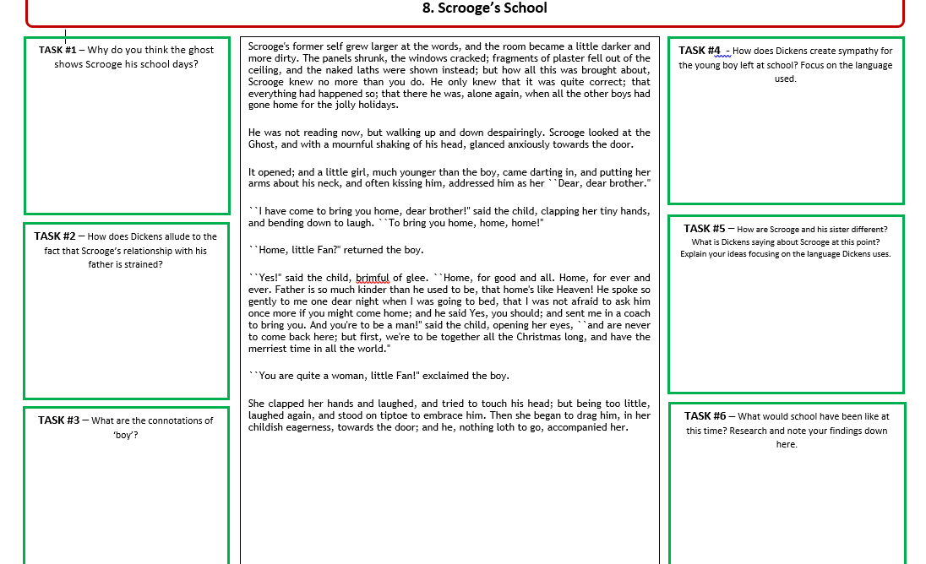

Slide 3
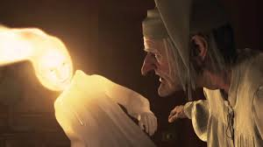
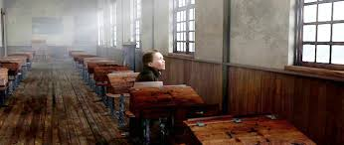
EXTENSION: Author’s Craft: What is Dickens doing to the reader’s feelings for Scrooge in Stave Two? Why create Old Scrooge and change our opinion with Young Scrooge?
Key words: Authorial intent Theme Moral growth Contrast Paradox Welfare Redemption Juxtaposition Symbolism Contradiction Memory Hope Reclamation

