Slide 1
A Christmas Carol Scrooge’s unhappy childhood. LO: To explore Dickens use of memories. ST: I can analyse the emotional response of Scrooge.
Key words: Authorial intent Theme Moral growth Contrast melancholy Ali Baba Redemption glee Symbolism meagre Memory Hope decanter hoar-frost

Slide 2
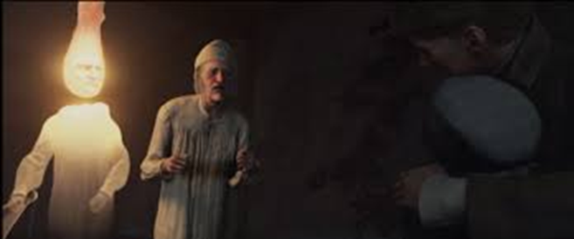
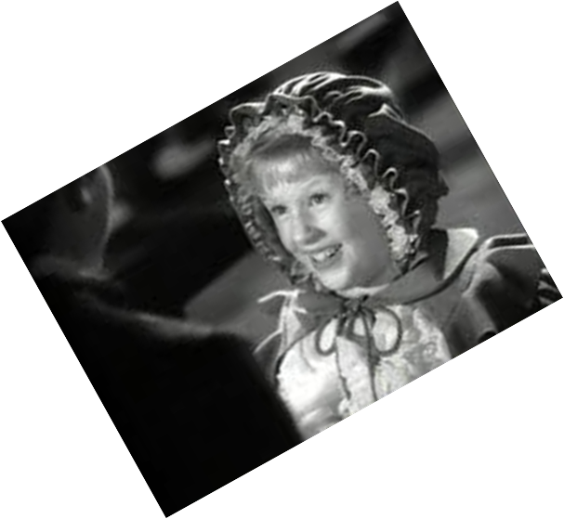
Starter: Let’s read from page 28 (bottom of page) to 34 (bottom) – up to Fezziwig’s ball.
Key words: Authorial intent Theme Moral growth Contrast melancholy Ali Baba Redemption glee Symbolism meagre Memory Hope decanter hoar-frost

Slide 3
Task: Why does Dickens use Fan as a contrast to Scrooge? How does Dickens portray Scrooge’s childhood? What does Fan suggest about the future that Scrooge could have looked forward to? Do we wonder why Scrooge is so unfriendly to his nephew? Why is it important for Scrooge to react emotionally to his younger self?
‘darting in...’
‘brimful of glee…’
‘heaven…’
‘to be a man…’
‘I have come to bring you home dear brother!’
‘she clapped her hands and laughed…’
Key words: Authorial intent Theme Moral growth Contrast melancholy Ali Baba Redemption glee Symbolism meagre Memory Hope decanter hoar-frost

Slide 4
Task: KEY CONTEXT – AO3
Why does Dickens include intertextuality between characters from the Arabian Nights?
What exactly does the contrast between the countryside and the city suggest? Why does Dickens emphasise this distinction in difference?
Key words: Authorial intent Theme Moral growth Contrast melancholy Ali Baba Redemption glee Symbolism meagre Memory Hope decanter hoar-frost

Slide 5
Plenary: Storyboard Scrooge’s changing emotions.
Key words: Authorial intent Theme Moral growth Contrast melancholy Ali Baba Redemption glee Symbolism meagre Memory Hope decanter hoar-frost

