Slide 1
A Christmas Carol LO: To write a short essay on Scrooge’s characterisation. ST: I can develop a critical style and write with purpose.

Slide 2
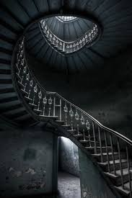
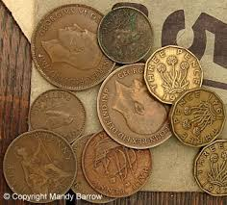
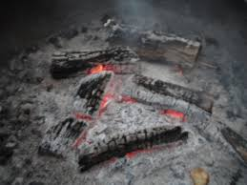
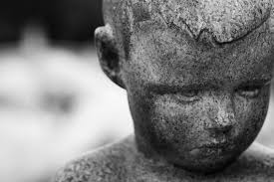
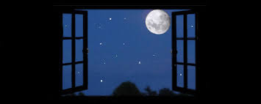
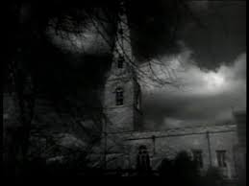
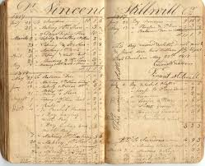
Task: Make a connection between Scrooge and the images below.

Slide 3
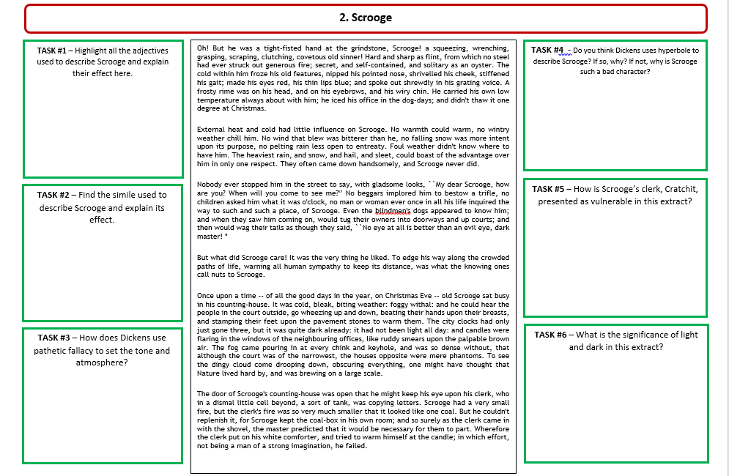

Slide 4
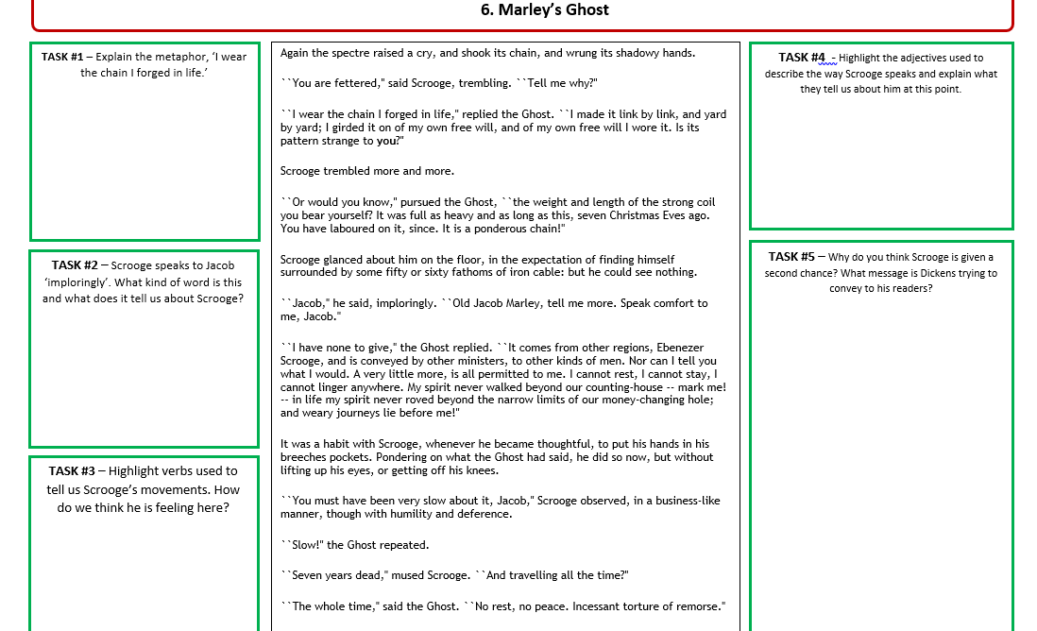

Slide 5
Activity: Quotation Hunt
You must spend the next 10-15 minutes of the lesson selecting evidence from Stave One to include in your essay.
Be sure to:
Choose short quotations
Choose quotations that lead you to different ideas about Scrooge’s character
Aim for 3-5 quotations – pg.2, pg.3, pg.5, pg.6, pg.10, pg.13

Slide 6
Essay: Scrooge’s Characterisation
You are going to write a short essay on the following question:
How does Dickens present Scrooge’s character in Stave One?
Assessment Criteria:
Show you understand the character and his relationships
Use evidence to support your ideas
Analyse the language closely (layers of meaning)
Make references to the historical context
Essay Structure:
Introduction (short overview);
Three PETER paragraphs (in chronological order);
Conclusion (summarise your main ideas).
Essay Length:
1 - 1.5 pages in your exercise book

Slide 7
Scrooge’s characterisation LO: To write a GSCE style response using the PETER structure. ST: I can be confident in analysing quotations.
Starter:
What do we know about Scrooge so far?
What is his personality like?
Why does Dickens present him like this? Do we as a reader like him?
Which other characters feature in Stave 1?
How does Scrooge react to them?
What is the weather like? Why does Dickens create this atmosphere?
What does Scrooge and the weather have in common?
Is Scrooge different at the end of Stave 1 from the beginning?

Slide 8
Essay: Scrooge’s Characterisation
Essay Structure:
Introduction (short overview);
The novel A Christmas Carol is about a man called Scrooge who is a …
Three PETER paragraphs (in chronological order);
Paragraph 1:
At the beginning of Stave 1 Scrooge is described as … - “ Solitary as an oyster.” ,
“ A covetous old sinner”, “ “He iced his office in the dog-days; and didn’t thaw it one degree at Christmas.” FIND TWO MORE QUOTES –
Paragraph 2:
Scrooge is shown to be rude to two charity workers he… “decrease the surplus population” , “Are there no prisons?”, FIND TWO MORE QUOTES –
Paragraph 3:
At the end of Stave 1 Scrooge is visited by Jacob Marley and is told … “for the very spectre’s voice disturbed the very marrow in his bones” , “Scrooge fell upon his knees, and clasped his hands before his face.” “Scrooge trembled more and more”, FIND TWO MORE QUOTES –
Conclusion (summarise your main ideas).
Essay Length:
1 page in your exercise book

Slide 9
Plenary: Read through. Check clarity and purpose. Check SPAG

