Slide 1
A Christmas Carol End of Topic Assessment
LO: To use the context question check list to help structure my essay.
ST: I can answer with confidence.

Slide 2
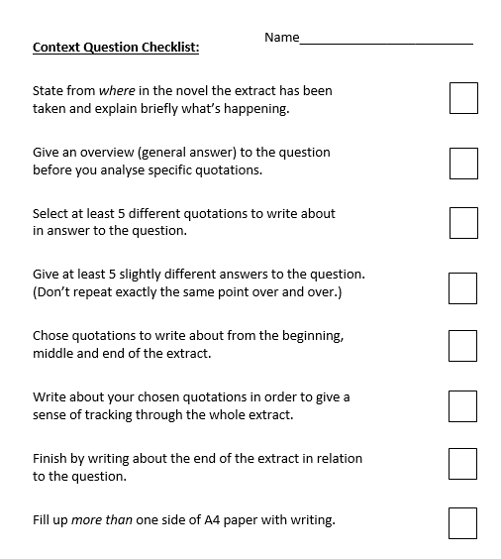
Let’s read through the checklist. This will help you to focus on the task. You have the rest of the lesson to write your response.

Slide 3
Practice Question
Starting with the extract. How does Dickens present the redeemed character of Scrooge?
Write about:
how Dickens presents Scrooge in this extract
how Dickens presents Scrooge at the start of the novella
The extract
"I don't know what to do!" cried Scrooge, laughing and crying in the same breath; and making a perfect Laocoön of himself with his stockings. "I am as light as a feather, I am as happy as an angel, I am as merry as a schoolboy. I am as giddy as a drunken man. A merry Christmas to everybody! A happy New Year to all the world. Hallo here! Whoop! Hallo!"
He had frisked into the sitting-room, and was now standing there: perfectly winded.
"There's the saucepan that the gruel was in!" cried Scrooge, starting off again, and going round the fireplace.
"There's the door, by which the Ghost of Jacob Marley entered! There's the corner where the Ghost of Christmas Present, sat! There's the window where I saw the wandering Spirits! It's all right, it's all true, it all happened. Ha ha ha!"
Really, for a man who had been out of practice for so many years, it was a splendid laugh, a most illustrious laugh. The father of a long, long line of brilliant laughs!
From Stave V, A Christmas Carol

