Slide 1
A Christmas Carol Themes LO: To understand how Dickens uses language to help shape our understanding of a key theme.
ST: I can comment on the effect of language and hit AO2.

Slide 2
Thinking task : Dickens uses settings to support the action in the novella. Add as many details as you can to the sub-headings below. Which are presented as aspirations, and which are used as warnings?
LONDON
HAPPY HOMES
ISOLATED PLACES
Notes:
Happy homes are presented as ideals of living. London – Scrooge’s chambers, pawn-shop, BUT change to light etc. at end

Slide 3
Task: Key themes – Match the quote from your handout to the key themes below.
Responsibility
Change
Poverty
Education
isolation
The supernatural
The family

Slide 4
Match the quotation to the key theme.
Scrooge -‘What’s Christmas to you but a time … for finding yourself a year older, and not an hour richer.’
Fred -‘Think of people below them as if they really were fellow-passengers to the grave, and not another race of creatures bound on other journeys’.
Marley- ‘mankind was my business.’
Scrooge –‘have they no refuse or resource?’
Ghost of Christmas Present – “They are Man’s,” said the spirit, looking down upon them.’
Ghost of Christmas Present – ‘Beware them both… stretching out its hand towards the city.’
‘In misery’s every refuge.’
Ghost of Christmas Present – ‘from the foldings of its robe, it brought two children; wretched, abject, frightful, hideous, miserable.’
Mrs Cratchit – ‘Brave in ribbons.’
Cratchits – ‘nobody said or thought it was at all a small pudding for a large family.’
Cratchits – ‘eked out by apple sauce and mashed potatoes,’
Charity collectors – ‘many thousands are in want of common necessaries.’
Charity collectors – ‘would rather die.’
Marley shows – ‘a wretched woman with an infant… upon a door-step.’
City –‘reeked with crime, with filth, and misery.’
Marley – ‘Marley was dead: to begin with.’
Scrooge – ‘He looked the phantom through and through.’
Scrooge – ‘Unearthly visitor.’
Ghost of Christmas yet to Come – ‘draped and hooded, coming like a mist along the ground.’
‘A lonely boy was reading near a feeble fire.’
‘And there he sat alone. Quite alone in the world I do believe.’
Fezziwig – ‘full of gratitude.’
Fezziwig – ‘In came Mrs Fezziwig…In came the three Miss Fezziwigs, beaming and lovable.’
Fan – ‘Father is so much kinder than he used to be.’
Scrooge – ‘a second father.’
‘Scrooge’s niece, by marriage, laughed as heartily as he.’

Slide 5
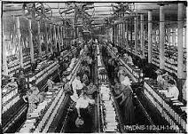
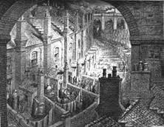
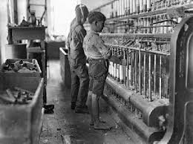
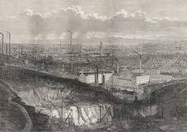
Research as much as you can about the Industrial Revolution and it’s influence on Victorian society. Think about how it links to A Christmas Carol.
TASK: Using the internet make a FACT FILE page to revise context.

Slide 6
Make 15 revision cards for A Christmas Carol. THREE for each stave.
ONE for CHARACTER
One for THEME
One for PLOT
Include quotations, key ideas, context and Dicken’s message. Colour code them for easy reference.

