Slide 1
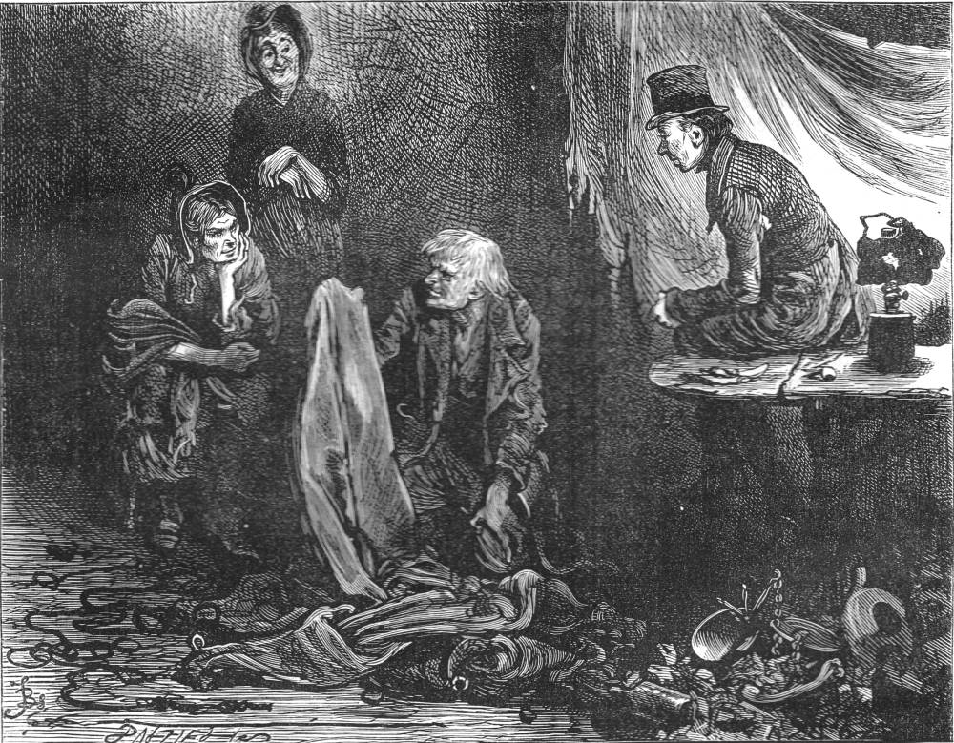
A Christmas Carol
Scrooge’s Debtors
LO: To reflect on Scrooge’s transformation
Key words: den cesspool poverty offal disgorged slunk
crime misery doom sepulchres infamous plunder

Slide 2
Starter: Read page 77 - 85
Key words: den cesspool poverty offal disgorged slunk
crime misery doom sepulchres infamous plunder

Slide 3
Task: Context Question, this is the ugly side of the city.
They left the busy scene, and went into an obscure part of the town, where Scrooge had never penetrated before, although he recognised its situation, and its bad repute. The ways were foul and narrow; the shops and houses wretched; the people half-naked, drunken, slipshod, ugly. Alleys and archways, like so many cesspools, disgorged their offenses of smell, and dirt, and life, upon the straggling streets; and the whole quarter reeked with crime, with filth, and misery.
Far in this den of infamous resort, there was a low-browed, beetling shop, below a pent-house roof, where iron, old rags, bottles, bones, and greasy offal, were bought. Upon the floor within, were piled up heaps of rusty keys, nails, chains, hinges, files, scales, weights, and refuse iron of all kinds. Secrets that few would like to scrutinise were bred and hidden in mountains of unseemly rags, masses of corrupted fat, and sepulchres of bones. Sitting in among the wares he dealt in, by a charcoal stove, made of old bricks, was a grey-haired rascal, nearly seventy years of age; who had screened himself from the cold air without, by a frowsy curtaining of miscellaneous tatters, hung upon a line; and smoked his pipe in all the luxury of calm retirement.
How does Dickens present the setting in the following extract?
Tips for success:
Look for 4 ideas
Keep highlighted evidence short
Analyse language closely (always look for layers of meaning)
Ask yourself: how does this add to/change the atmosphere?
Track through and find points across the entire extract
Key words: den cesspool poverty offal disgorged slunk
crime misery doom sepulchres infamous plunder

Slide 4
Characterisation: Dickens creates four unpleasant characters to show the depravity that greed can cause. Draw a grid like the one below, scan the pages for details on these characters. Find as many quotes as you can.
 | Quotations: Dialogue and actions. | Explanations
Old Joe
Mrs Dilber
A charwoman
An Undertaker’s man
Key words: den cesspool poverty offal disgorged slunk
crime misery doom sepulchres infamous plunder

Slide 5
Question: How does Scrooge react to the shrouded dead body? Why is he reluctant to lift the sheet? Using the quotes below write a detailed paragraph to answer the question.
‘He lay ,in the dark empty house, with not a man, a woman, or a child, to say that he was kind to him.’
‘one feature odious’
‘This is a fearful place’
‘such terrors…’
‘And longed to do it but had no more power to withdraw the veil than dismiss than to dismiss the spectre at his side.’
‘And on it, plundered and bereft, unwatched, unwept, uncared for…’
‘Oh cold, cold, rigid dreadful death, set up thine altar here…’
Key words: den cesspool poverty offal disgorged slunk
crime misery doom sepulchres infamous plunder
Notes:
Highly emotive language to describe the corpse. List of adjectives with the repeated negative prefix ‘un’ to create an overwhelming sense of neglect and pity.

Slide 6
The young couple? Why has Dickens included them in this Stave?
The young couple demonstrate unexpected emotion at the death of the man.
Ashamed of the natural relief at the death – it gives them breathing space.
Scrooge’s demise has given them hope.
The death of the man is good news for them.
Key words: den cesspool poverty offal disgorged slunk
crime misery doom sepulchres infamous plunder

