Slide 1
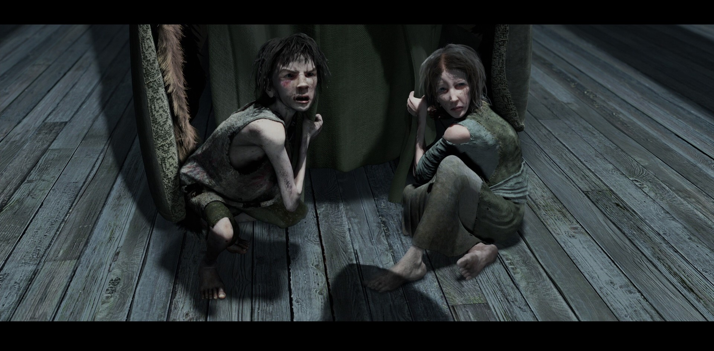
A Christmas Carol
Ignorance & Want
LO: To explore the significance of Ignorant and Want.
ST: I can gain a deeper understanding of Dickens’ moral message.
Key words: Allegory hope poverty abject wretched
humility prostrate wolfish doom appalled Factious
Notes:
Factious = likely to argue or disagree (dissension) Abject = completely without pride or dignity Ignorant=lacking knowledge or awareness in general; uneducated or unsophisticated.
Want = lack something desirable or essential.

Slide 2
Starter: What do you think ignorance and want mean? In your books write a definition for ignorance and want. How do they relate to society today?
Ignorant = lacking knowledge or awareness in general; uneducated or unsophisticated.
Want = lack something desirable or essential.
Key words: Allegory hope poverty abject wretched
humility prostrate wolfish doom appalled Factious

Slide 3
Starter Activity: Textual Analysis
‘Forgive me if I am not justified in what I ask," said Scrooge, looking intently at the Spirit's robe, "but I see something strange, and not belonging to yourself, protruding from your skirts. Is it a foot or a claw?"
"It might be a claw, for the flesh there is upon it," was the Spirit's sorrowful reply. "Look here."
From the foldings of its robe, it brought two children; wretched, abject, frightful, hideous, miserable. They knelt down at its feet, and clung upon the outside of its garment.’
1. Why is Scrooge appalled by these children?
2. What might their significance be?
3. What does the list of adjectives remind you of?
Key words: Allegory hope poverty abject wretched
humility prostrate wolfish doom appalled Factious

Slide 4
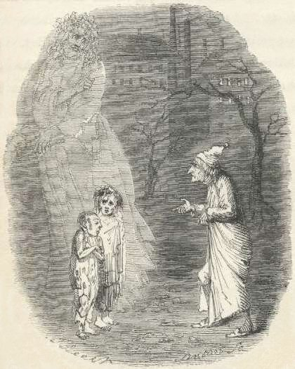
Ignorance and Want
A representation of an abstract or
spiritual meaning through
concrete or material forms; figurative
treatment of one subject under
the guise of another.
The two children are allegories of two social problems: Ignorance and Want. They represent these problems in human form.
Notice: They have capital letters to show this.
Key words: Allegory hope poverty abject wretched
humility prostrate wolfish doom appalled Factious

Slide 5
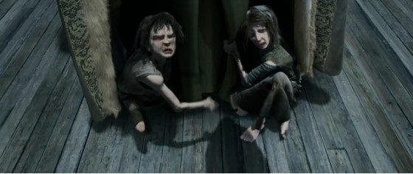
Dickens is promoting the need for education and its role in eradicating Want through knowledge.
Ignorance: People like Scrooge, who ignore the problems of the poor, create enormous social problems. They create children like this.
Want: because the population has ‘boomed’ in Victorian times, many people ‘want for’ (go without) the basic necessities such as food and shelter. Combined with the ignorance of the rich, this creates massive social problems. It creates children like this.
These children will grow into adults who live a life of crime, causing bigger problems and creating a cycle.
Key words: Allegory hope poverty abject wretched
humility prostrate wolfish doom appalled Factious

Slide 6
Task: Ignorance & Want Questions
Answer the questions on the worksheet about Ignorance & Want.
Note:
Ignorance & Want are vital to understanding Dickens’ social message.
You can use them as an example in most essays in the exam!
Key words: Allegory hope poverty abject wretched
humility prostrate wolfish doom appalled Factious

Slide 7
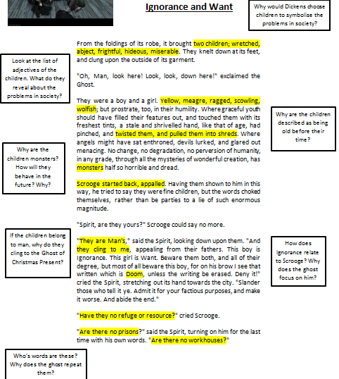
Write your answers in an essay style using quotations from the text.
Key words: Allegory hope poverty abject wretched
humility prostrate wolfish doom appalled Factious

