Slide 1
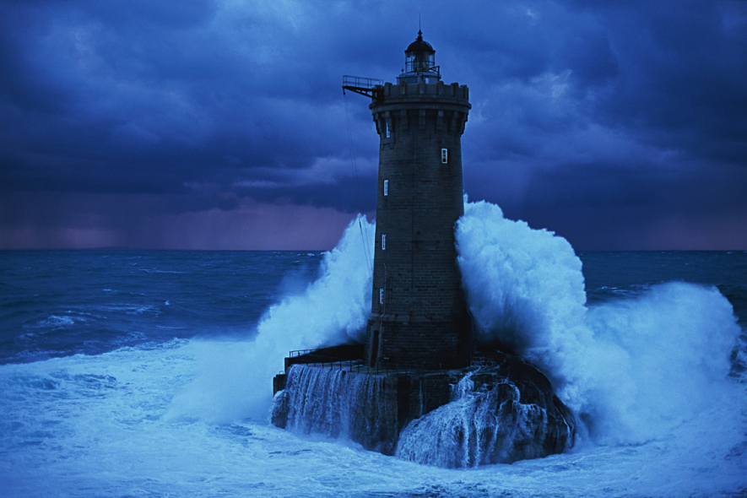
A Christmas Carol
The Lighthouse
LO: To analyse language and explore the writer’s craft.
ST: I can effectively answer exam style questions.

Slide 2
Starter: What is atmosphere? What techniques do writers’ use? In pairs discuss your ideas, write them in your books: ready to feedback.

Slide 3
Task: Atmosphere Context Question
You have twenty five minutes to complete the question
(5 minutes to read/annotate and 15 minutes to write – 5 minutes to check).
Aim to write 1-1.5 pages in your exercise book.
Exam conditions!
How does Dickens create mood and atmosphere in the following extract?
Tips for success:
Look for 5-6 ideas
Keep highlighted evidence short
Analyse language closely (always look for layers of meaning)
Ask yourself: how does this add to/change the atmosphere?
Track through and find points across the entire extract

Slide 4
Stave 3: Atmosphere Context Question How does Dickens create mood and atmosphere in the following extract?
The Spirit did not tarry here, but bade Scrooge hold his robe, and passing on above the moor, sped -- whither. Not to sea? To sea. To Scrooge's horror, looking back, he saw the last of the land, a frightful range of rocks, behind them; and his ears were deafened by the thundering of water, as it rolled and roared, and raged among the dreadful caverns it had worn, and fiercely tried to undermine the earth.
Built upon a dismal reef of sunken rocks, some league or so from shore, on which the waters chafed and dashed, the wild year through, there stood a solitary lighthouse. Great heaps of sea-weed clung to its base, and storm-birds -- born of the wind one might suppose, as sea-weed of the water -- rose and fell about it, like the waves they skimmed.
But even here, two men who watched the light had made a fire, that through the loophole in the thick stone wall shed out a ray of brightness on the awful sea. Joining their horny hands over the rough table at which they sat, they wished each other Merry Christmas in their can of grog; and one of them: the elder, too, with his face all damaged and scarred with hard weather, as the figure-head of an old ship might be: struck up a sturdy song that was like a Gale in itself.
Again the Ghost sped on, above the black and heaving sea -- on, on -- until, being far away, as he told Scrooge, from any shore, they lighted on a ship. They stood beside the helmsman at the wheel, the look-out in the bow, the officers who had the watch; dark, ghostly figures in their several stations; but every man among them hummed a Christmas tune, or had a Christmas thought, or spoke below his breath to his companion of some bygone Christmas Day, with homeward hopes belonging to it. And every man on board, waking or sleeping, good or bad, had had a kinder word for another on that day than on any day in the year; and had shared to some extent in its festivities; and had remembered those he cared for at a distance, and had known that they delighted to remember him.

Slide 5
Stave 3: Atmosphere Context Question How does Dickens create mood and atmosphere in the following extract?
Use of adjectives to make the atmosphere forbidding/scary/dangerous/hostile
The Spirit did not tarry here, but bade Scrooge hold his robe, and passing on above the moor, sped -- whither. Not to sea? To sea. To Scrooge's horror, looking back, he saw the last of the land, a frightful range of rocks, behind them; and his ears were deafened by the thundering of water, as it rolled and roared, and raged among the dreadful caverns it had worn, and fiercely tried to undermine the earth.
Built upon a dismal reef of sunken rocks, some league or so from shore, on which the waters chafed and dashed, the wild year through, there stood a solitary lighthouse. Great heaps of sea-weed clung to its base, and storm-birds -- born of the wind one might suppose, as sea-weed of the water -- rose and fell about it, like the waves they skimmed.
But even here, two men who watched the light had made a fire, that through the loophole in the thick stone wall shed out a ray of brightness on the awful sea. Joining their horny hands over the rough table at which they sat, they wished each other Merry Christmas in their can of grog; and one of them: the elder, too, with his face all damaged and scarred with hard weather, as the figure-head of an old ship might be: struck up a sturdy song that was like a Gale in itself.
Again the Ghost sped on, above the black and heaving sea -- on, on -- until, being far away, as he told Scrooge, from any shore, they lighted on a ship. They stood beside the helmsman at the wheel, the look-out in the bow, the officers who had the watch; dark, ghostly figures in their several stations; but every man among them hummed a Christmas tune, or had a Christmas thought, or spoke below his breath to his companion of some bygone Christmas Day, with homeward hopes belonging to it. And every man on board, waking or sleeping, good or bad, had had a kinder word for another on that day than on any day in the year; and had shared to some extent in its festivities; and had remembered those he cared for at a distance, and had known that they delighted to remember him.
Mood changes – focus on the people and their warmth/ festive spirit/ happiness
Atmosphere changes to the description of nature and how powerful it is – a dark/ inhospitable/cold/
threatening/risky mood is created.

Slide 6
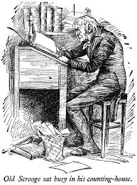
Plenary Activity: Peer Assessment
Switch books with your partner.
Have they used the PETER structure?
Have they stayed focused on the question?
Have they tried to use all three ways of embedding quotations?
Use the sheet to help you phrase your critique.

