Slide 1
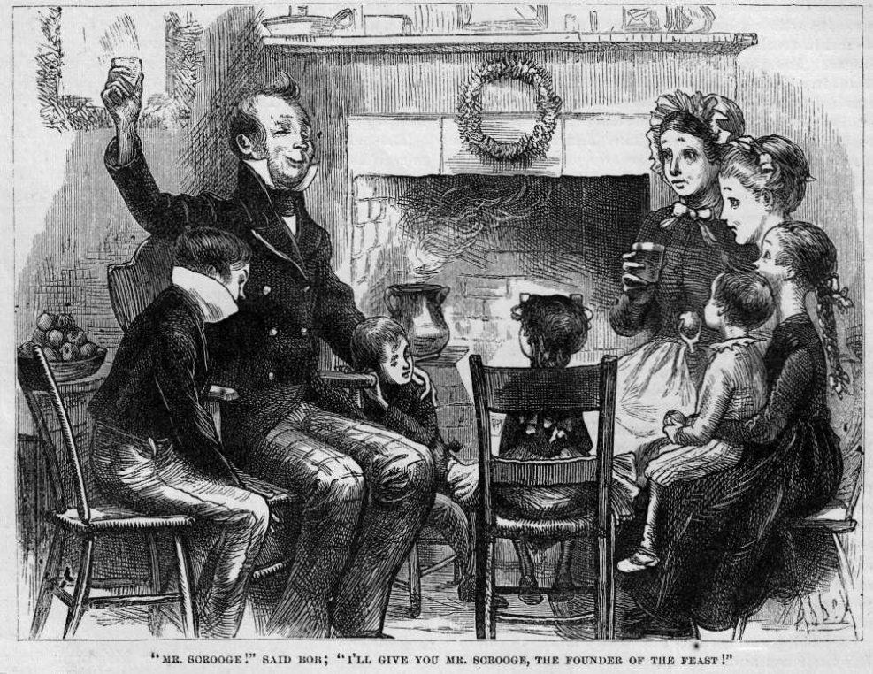
A Christmas Carol
The Cratchit Family Christmas
LO: To examine the Cratchits as the face of the poor.
ST: I can empathise with their situation.
Key words: shawl prematurely pawn broker ubiquitous eked bear witness heresy penitence rebuke odious ogre
Notes:
Ubiquitous =present, appearing, or found everywhere.

Slide 2
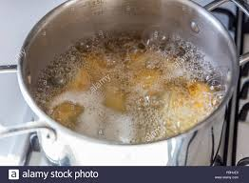
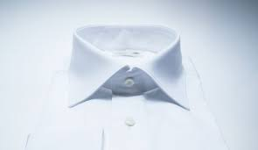
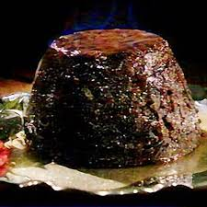
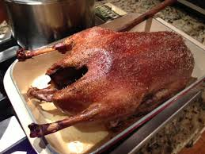
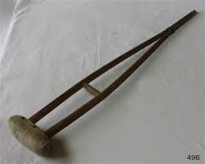
Starter: Re- cap the Cratchits Christmas. Make a connection between an image below and what we have read.

Slide 3
Let’s read! Page 53- 60.
Key words: shawl prematurely pawn broker ubiquitous eked bear witness heresy penitence rebuke odious ogre

Slide 4
KEY CONTEXT AO 3
The saintly disabled child is a stock character of Victorian literature. Dickens uses Tim to provoke sympathy and elicit support for his social message – he is the embodiment of
‘surplus population’. Victorian England was a very different place than today, such characters as Tim had no independent means. The economy valued those who could contribute physically, especially with a move from agriculture to industrial manufacture.
The leg iron that Tim wears, his ‘little crutch’ and ‘iron frame,’ serve as a metaphor that entraps as much as they support.
Dickens wants people to reflect on the inequality in society.
Key words: shawl prematurely porn broker ubiquitous eeked bear witness heresy penitence rebuke odious ogre
Key words: shawl prematurely pawn broker ubiquitous eked bear witness heresy penitence rebuke odious ogre

Slide 6
Let’s read: Page 61-63
Key words: shawl prematurely pawn broker ubiquitous eked bear witness heresy penitence rebuke odious ogre
Key words: shawl prematurely porn broker ubiquitous eeked bear witness heresy penitence rebuke odious ogre

Slide 7
Other Christmas ‘presents’
The Ghost takes Scrooge to visit the miners, the men who tend the lighthouse and men on a ship at sea.
What is key to how these other Christmases are shown?
Regardless of where the Ghost takes Scrooge on this Christmas night, everyone is celebrating the festive season
Key words: shawl prematurely porn broker ubiquitous eeked bear witness heresy penitence rebuke odious ogre
Key words: shawl prematurely pawn broker ubiquitous eked bear witness heresy penitence rebuke odious ogre

Slide 8
Task: Comprehension Questions
1. Why might Dickens include a scene in which the Cratchit family cook their Christmas meal?
3. Why might Dickens include the image of Bob carrying his son?
4. How are the references to church important?
5. Why might Bob say that his son is “good as gold”?
6. How do the Cratchit family feel about their meal?
7. How does Scrooge react to watching this scene?
8. Why might Dickens include Bob toasting Scrooge as the “founder of the feast”?
9. Overall, what is the atmosphere in this scene?
WRITE IN FULL SENTENCES!

