Slide 1
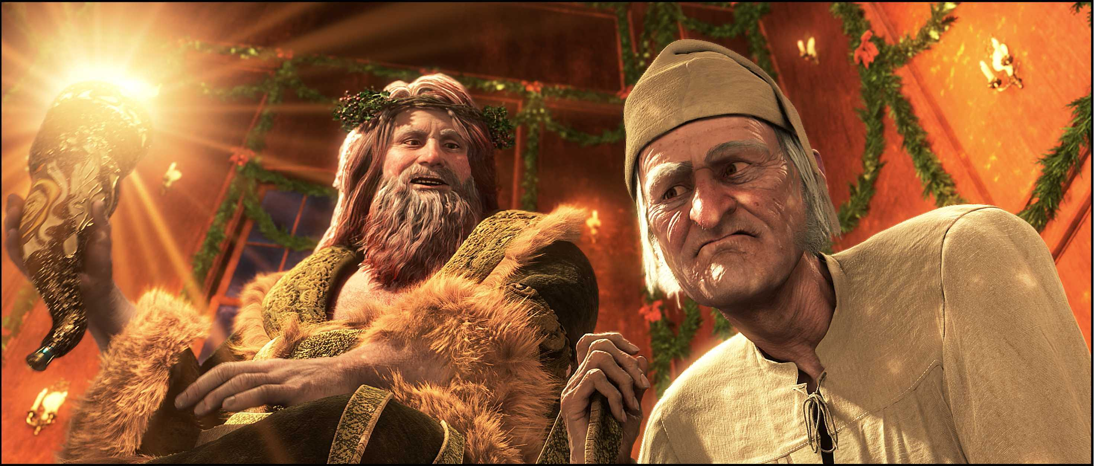
A Christmas Carol
The Ghost of Christmas Present
LO: To learn about historical context and the symbolism of TG of CPR.
ST: I can analyse language and structure.

Slide 2
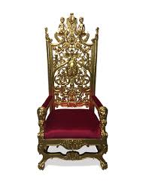
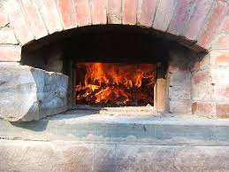
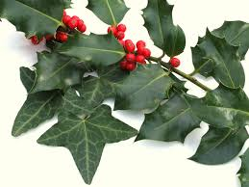
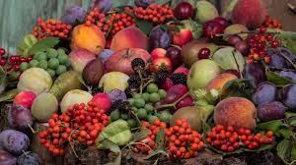
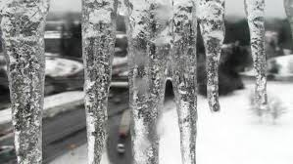
Starter: Make a connection between the image and what we have read in Stave 3.
Notes:
Scabbard – empty?
Baker’s oven to cook goose
Holly and ivy around ghost’s headdress
Throne of food
Icicles – harsh weather juxtaposition – hanging from his headdress
Sprinkles magic from his cornucopia to share good will
Food from the shop windows

Slide 3
Historical Context: A Victorian Christmas
Before Victoria's reign started in 1837, nobody in Britain had heard of Santa Claus or Christmas Crackers. No Christmas cards were sent and most people did not have holidays from work. The wealth and technologies generated by the industrial revolution of the Victorian era changed the face of Christmas forever..
Sentimental do-gooders like Charles Dickens wrote books like "Christmas Carol", published in 1843, which actually encouraged rich Victorians to redistribute their wealth by giving money and gifts to the poor - Humbug! These radical middle class ideals eventually spread to the not-quite-so-poor as well.
How is this information important to understanding A Christmas Carol?

Slide 4
Historical Context: Santa Claus
Father Christmas or Santa Claus: The two are in fact two entirely separate stories. Father Christmas was originally part of an old English midwinter festival, normally dressed in green, a sign of the returning spring. The stories of St. Nicholas (Sinter Klaas in Holland) came via Dutch settlers to America in the 17th Century. From the 1870's Sinter Klass became known in Britain as Santa Claus and with him came his unique gift and toy distribution system - reindeer and sleigh.
How is this information important to understanding A Christmas Carol?

Slide 5
Use your image and add as many quotations about the Ghost of Christmas Present around it.

Slide 6
Complete the quotation drill before answering the quick question using the line you have analysed in the grid.
‘there sat a jolly Giant, glorious to see, who bore a glowing torch… to shed its light on Scrooge.’
Who/what is the quotation about? What does the quotation mean? What does the quotation suggest? | Pick ONE word that shifts the tone of the novella from melancholy to something else. Explain your decision. | Why is this ghost ‘glorious to see’? What can we infer about this ghost compared to the two that have come before? | What is the significance of light in the novel? Why is it important that its light is ‘shed… on Scrooge’?
What is Dickens’ authorial intent? What is he trying to say about what Christmas can teach us through this quotation? | How can you connect this quotation to other areas of the text? Consider ideas from all staves. | What similarities does this ghost share with Christmas time? Consider each part of the quotation carefully.
Now write a paragraph which answers this question. In your response, use the quotation you have just analysed: How does Dickens present ideas about Christmas through the Ghosts?
Which topics can this quotation be filed under? One has already been done for you:
- Redemption
Notes:
@SPryke2

Slide 7
What is Dickens using The Ghost of Christmas Present for?
Task: Write 2 detailed paragraphs answering this question above. Remember to show your historical content knowledge to hit AO3.
ALSO THINK ABOUT:
Does Dickens hint at inequality in society? How?
Has Scrooge learned to change yet?
What is the argument for Sabbatarianism?

