Slide 1
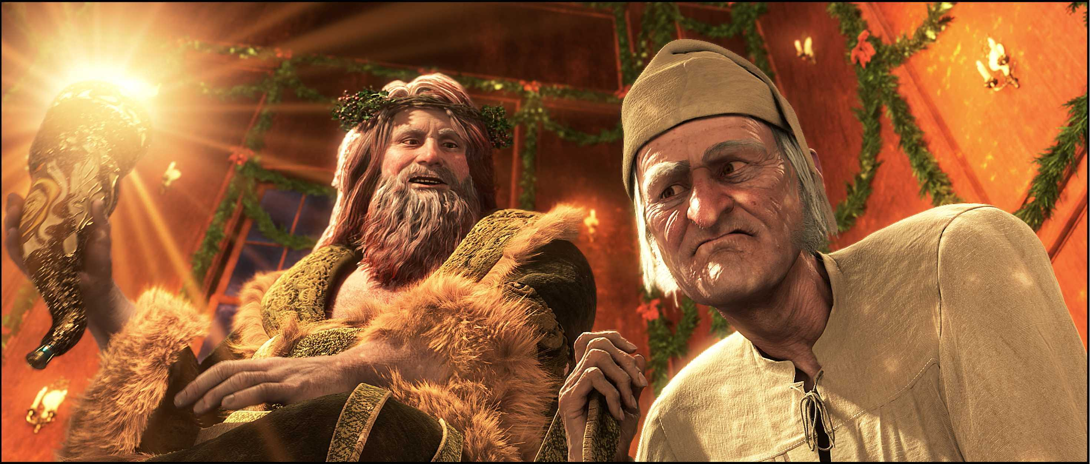
A Christmas Carol
The Ghost of Christmas Present
LO: To understand the importance of The Ghost of Christmas Present.
ST: I can analyse language and structure.
Key words: Prodigiously transformation cornucopia scabbard reverently capacious genial bigotry deprive supernatural
Notes:
Prodigiously = remarkably or impressively great in extent, size, or degree.

Slide 2
Starter: The memories are very significant – you must remember them and know their significance. Create a timeline to show which event happened at which stage of Scrooge’s life. Against each event note the lessons Scrooge learned; add the most important quotation related to it.
First memory |  |  |  |  | Last memory
Key words: Prodigiously transformation cornucopia scabbard reverently capacious genial bigotry deprive supernatural

Slide 3
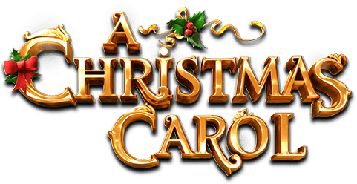
Complete the quotation drill before answering the quick question using the line you have analysed in the grid.
‘I have seen your nobler aspirations fall off one by one, until the master-passion, Gain, engrosses you.’
Who/what is the quotation about? What does the quotation mean? What does the quotation suggest? | What can we infer about Scrooge’s original aspirations? What could Belle’s aspirations be if they don’t match Scrooge’s? | Consider Scrooge’s passion: ‘Gain’. What was society like in Victorian London to cause ‘Gain’ to be his sole focus? | ‘Aspirations’ is a plural and ‘Gain’ is singular. What does this suggest to you?
What is Dickens’ authorial intent? What is he trying to say about people and their morals through this quotation? | How can you connect this quotation to other areas of the text? Consider ideas from all staves. | Complete single word analysis on the words ‘master-passion’ and ‘engrosses.’
Now write a paragraph which answers this question. In your response, use the quotation you have just analysed: How does Dickens present ideas about greed in the novel?
Which topics can this quotation be filed under? One has already been done for you:
- Fear
Notes:
@SPryke2

Slide 4
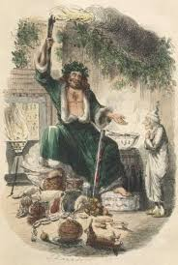
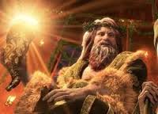
Task: Read Stave 3 – The Second of the Three Spirits. Page 45 – 53.
Key words: Prodigiously transformation cornucopia scabbard reverently capacious genial bigotry deprive supernatural

