Slide 1
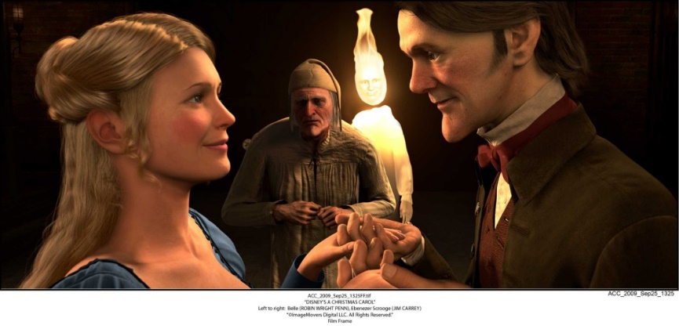
A Christmas Carol
Belle & The Engagement
LO: To examine the theme of greed.
ST: I can analyse the way Dickens shows happiness is not linked to money.
KEY WORDS: idol wealth pursuit yield repentance regret memory haunt resistance

Slide 2
Task: Fezziwig’s Party Questions
How do Mr and Mrs Fezziwig treat their workers at the end of the party?
Where do the prentices sleep? Why does Dickens add this detail?
How does Scrooge’s behaviour change throughout the party?
What is the ghost’s lesson for Scrooge to learn?
Where do the themes of the Christmas spirit and poverty appear in the party scene?
What do you think Scrooge would like to say to the clerks?
Key words: Jovial agility porter corroborated agitation avarice contrast negus business ethics

Slide 3
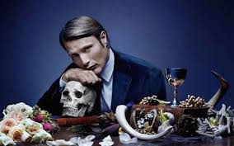
What do you associate with greed?
In pairs brainstorm your ideas.
KEY WORDS: idol wealth pursuit yield repentance regret memory haunt resistance

Slide 4
Task: Finish reading Stave 2: page 39-44.
KEY WORDS: idol wealth pursuit yield repentance regret memory haunt resistance

Slide 5
Look at the description Dickens introduces Belle with. Why does he make her tears sparkle?
‘He was not alone, but sat by the side of a fair young girl in a mourning-dress: in whose eyes there were tears, which sparkled in the light that shone out of the Ghost of Christmas Past.’
What is an idol?
KEY WORDS: idol wealth pursuit yield repentance regret memory haunt resistance

Slide 6
Key quotes:
‘there was an eager, greedy, restless motion in the eye, which showed the passion had taken root.’
These have left Scrooge now – what were they?
What is this ‘passion’? Also called avarice.
‘nobler aspirations’
‘In the life you have chosen’
Is there any regret? How do you know?
KEY WORDS: idol wealth pursuit yield repentance regret memory haunt resistance

Slide 7
Questions:
Answer in FULL sentences!
How does Dickens make it clear that greed will lead to unhappiness?
Belle breaks off the engagement, calling money Scrooge’s ‘idol’ what does this suggest about him? How has he changed since being an apprentice?
Dickens sets emotional love against Scrooge’s love for money – what does this make a reader feel?
The Stave ends with Belle happy in a loving marriage, what point is Dickens making?
KEY WORDS: idol wealth pursuit yield repentance regret memory haunt resistance

Slide 8
Activity: Stave Two Cloze Summary
Scrooge meets the Ghost of Christmas Past. It symbolises _________ as Scrooge must relive his past to reconnect with his former, _________ self. First, Scrooge watches himself as a lonely child in school. He cries for himself and the reader feels ___________ and begins to understand how he came to be so evil.
Scrooge takes the first step on the road to ___________ by regretting not giving money to a child who sung him a Christmas carol. He then watches his sister, __________, and we learn she dies – Scrooge feels guilty about his nephew, ___________.
Scrooge watches __________ throw a party for his workers. Scrooge begins to enjoy himself and learns that living a _______________ is harmful and that being disconnected from people doesn’t make life better.
Finally, Scrooge watches the break-up of his ___________ with Belle: he becomes distressed as he is forced to see how a “____________” has become his obsession (i.e. money). Scrooge sits alone and realises he hasn’t had a friend since __________ and the ghost disappears; Scrooge falls into a deep sleep.
Scrooge meets the Ghost of Christmas Past. It symbolises memory as Scrooge must relive his past to reconnect with his former, innocent self. First, Scrooge watches himself as a lonely child in school. He cries for himself and the reader feels sympathy and begins to understand how he came to be so evil.
Scrooge takes the first step on the road to salvation by regretting not giving money to a child who sung him a Christmas carol. He then watches his sister, Little Fan, and we learn she dies – Scrooge feels guilty about his nephew, Fred.
Scrooge watches Fezziwig throw a party for his workers. Scrooge begins to enjoy himself and learns that living a solitary life is harmful and that being disconnected from people doesn’t make life better.
Finally, Scrooge watches the break-up of his engagement with Belle: he becomes distressed as he is forced to see how a “golden idol” has become his obsession (i.e. money). Scrooge sits alone and realises he hasn’t had a friend since Marley and the ghost disappears; Scrooge falls into a deep sleep.
Key words: Prodigiously transformation cornucopia scabbard reverently capacious genial bigotry deprive supernatural
Notes:
Prodigiously = remarkably or impressively great in extent, size, or degree.

