Slide 1
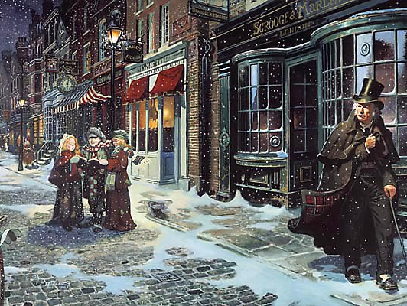
CONNECTIVES
In addition
Furthermore
Moreover
However
On the other hand
Additionally
Subsequently
Therefore
Consequently
As a result of
Significantly
You are assessed for Literature Assessment Objectives 1 and 2.
CHRIS RICE
Connotes
Highlights
Reinforces
Implies
Suggests
Reflects
Infers
Connotes
Emphasises
AVOID REPEATEDLY OPENING SENTENCES WITH ‘THE’
AVOID REPEATEDLY OPENING SENTENCES WITH ‘THIS’.
IT, AND, BUT, SO – DO NOT OPEN SENTENCES WITH THEM.
EXTRACT QUESTIONS – PETER
Point
Evidence
Technique/Terminology
Exploration
Reader
ESSAY QUESTIONS – PEAR
Point
Evidence
Analysis
Reader
PUNCTUATION:
Accurately demarcate sentences with
capital letters and full stops.
Use apostrophes accurately.
Use homophones accurately.
Your spellings should be accurate.
Punctuate your quotations accurately.
AVOID CONTRACTIONS E.G. CAN’T
REMEMBER THIS IS A PIECE OF FORMAL WRITING.
Some sentence stems:
The use of similes conveys a sense of ….to the reader.
Dickens highlights Scrooge’s harshness by….
With this quotation, Dickens is trying to illustrate how….is perceived by society.
The quotation infers that Scrooge feels…but on the other hand, it could also be interpreted as….
Consequently, the reader is encouraged to feel…
Dickens, as a person who believed in being charitable, is advocating the need to give to the poor through his depiction of…
Embed your quotations accurately:
For example, “……..”
……… says “………”
Through “……..”,…..
In the extract, Dickens writes “……..”
Dickens conveys ……..through the use of …..when he writers/Scrooge says “…….”.
BE ALERT
VOCABULARY
BECAUSE
As
Since
Through
Owing to
Due to
Resulting
Since
Attributable to
Being critical
Explaining
Author intentions
Language use
Embedding quotations
Reader response
Techniques used
Adjectives
Adverbs
Alliteration
Antithesis
Connotations
Dialogue
Foreshadowing
Hyperbole
Idiom
Irony
Juxtaposition
Metaphor
Nouns
Novella
Pathetic Fallacy
Pathos
Personification
Repetition
Similes
Symbolism
Verbs

Slide 2
CONNECTIVES
In addition
Furthermore
Moreover
However
On the other hand
Additionally
Subsequently
Therefore
Consequently
As a result of
Significantly
You are assessed for Literature Assessment Objectives 1 and 2.
CHRIS RICE
Connotes
Highlights
Reinforces
Implies
Suggests
Reflects
Infers
Connotes
Emphasises
AVOID REPEATEDLY OPENING SENTENCES WITH ‘THE’
AVOID REPEATEDLY OPENING SENTENCES WITH ‘THIS’.
IT, AND, BUT, SO – DO NOT OPEN SENTENCES WITH THEM.
EXTRACT QUESTIONS – PETER
Point
Evidence
Technique/Terminology
Exploration
Reader
ESSAY QUESTIONS – PEAR
Point
Evidence
Analysis
Reader
PUNCTUATION:
Accurately demarcate sentences with
capital letters and full stops.
Use apostrophes accurately.
Use homophones accurately.
Your spellings should be accurate.
Punctuate your quotations accurately.
AVOID CONTRACTIONS E.G. CAN’T
REMEMBER THIS IS A PIECE OF FORMAL WRITING.
Some sentence stems:
The use of similes conveys a sense of ….to the reader.
Dickens highlights Scrooge’s harshness by….
With this quotation, Dickens is trying to illustrate how….is perceived by society.
The quotation infers that Scrooge feels…but on the other hand, it could also be interpreted as….
Consequently, the reader is encouraged to feel…
Dickens, as a person who believed in being charitable, is advocating the need to give to the poor through his depiction of…
Embed your quotations accurately:
For example, “……..”
……… says “………”
Through “……..”,…..
In the extract, Dickens writes “……..”
Dickens conveys ……..through the use of …..when he writers/Scrooge says “…….”.
BE ALERT
VOCABULARY
BECAUSE
As
Since
Through
Owing to
Due to
Resulting
Since
Attributable to
Being critical
Explaining
Author intentions
Language use
Embedding quotations
Reader response
Techniques used
Adjectives
Adverbs
Alliteration
Antithesis
Connotations
Dialogue
Foreshadowing
Hyperbole
Idiom
Irony
Juxtaposition
Metaphor
Nouns
Novella
Pathetic Fallacy
Pathos
Personification
Repetition
Similes
Symbolism
Verbs

