Slide 1
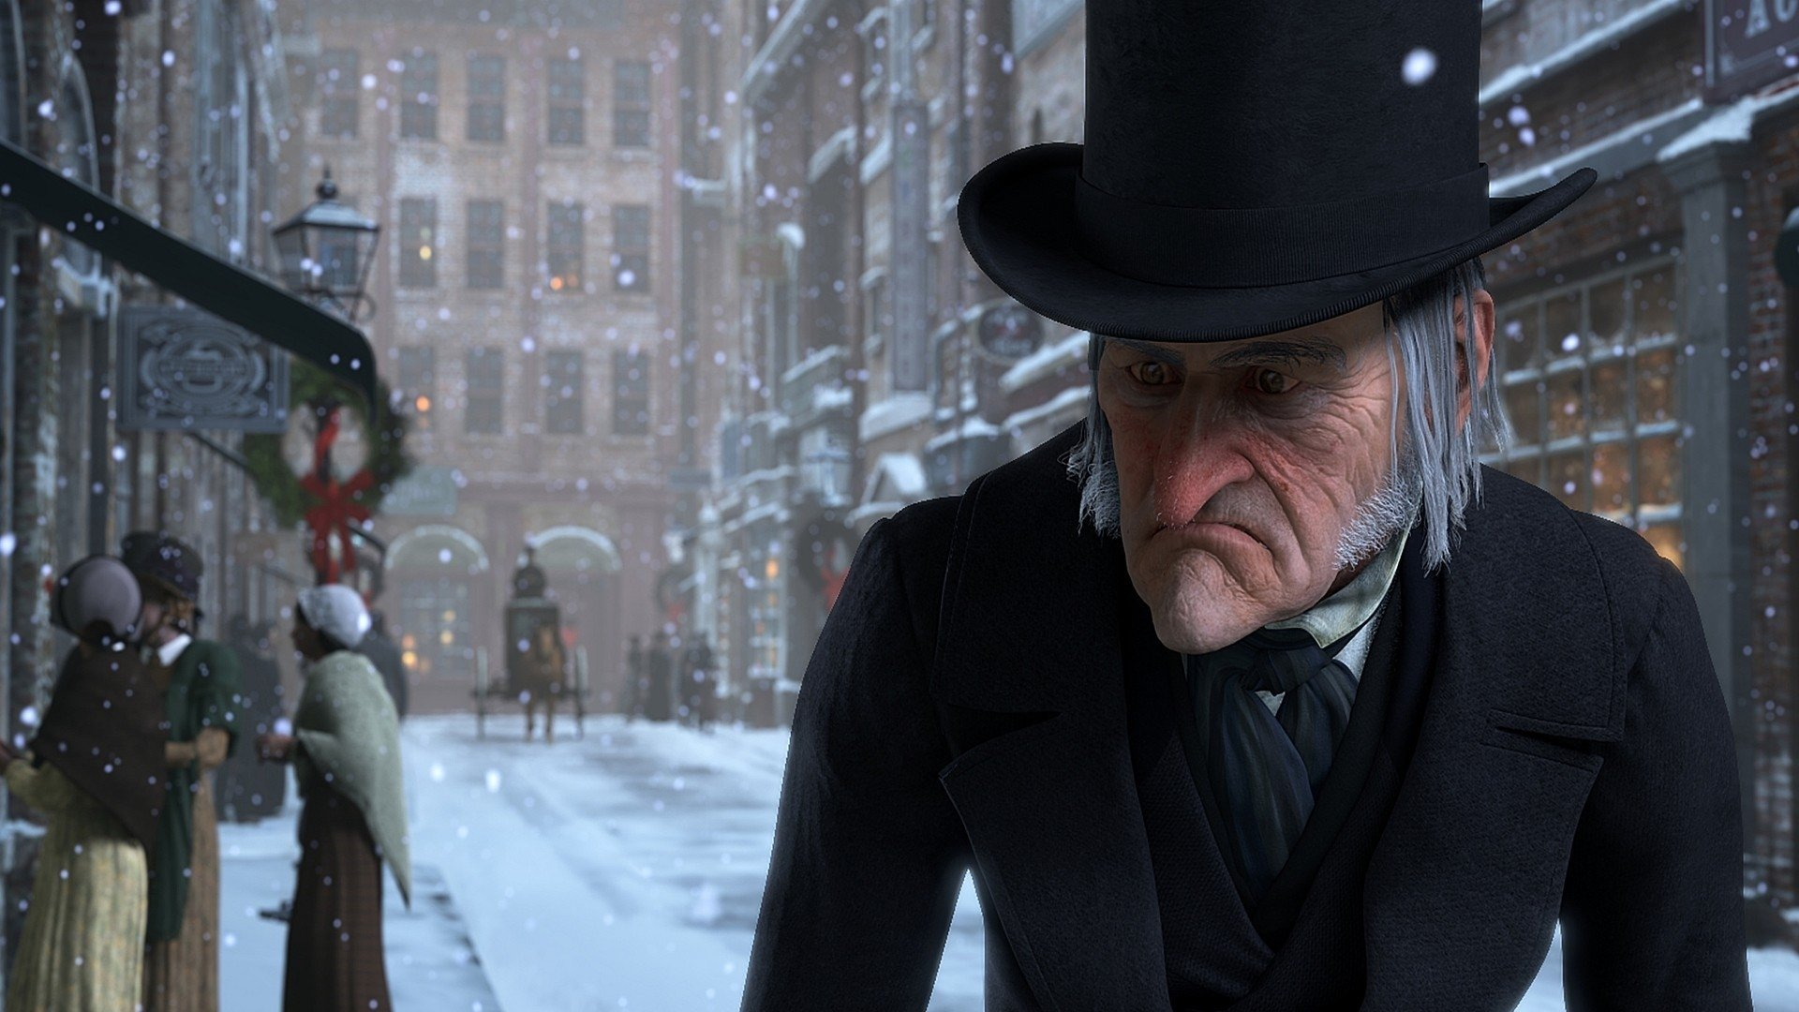
1: “Hard and sharp as flint”. Explain the significance of Dickens’ choice of “flint” in this simile and how it links to the motif of fire in the novella.
2: Explain the symbolic significance of Marley’s chains.
3: Finish the quotation – a comment by Scrooge about the poor: “If they had rather die, they had better do it and … … …”
4: Which of the following is the precise terminology for ‘main character’? A: deuteragonist B: antagonist C: protagonist
5: “I wear the chain … … …” Complete the quotation.

Slide 2
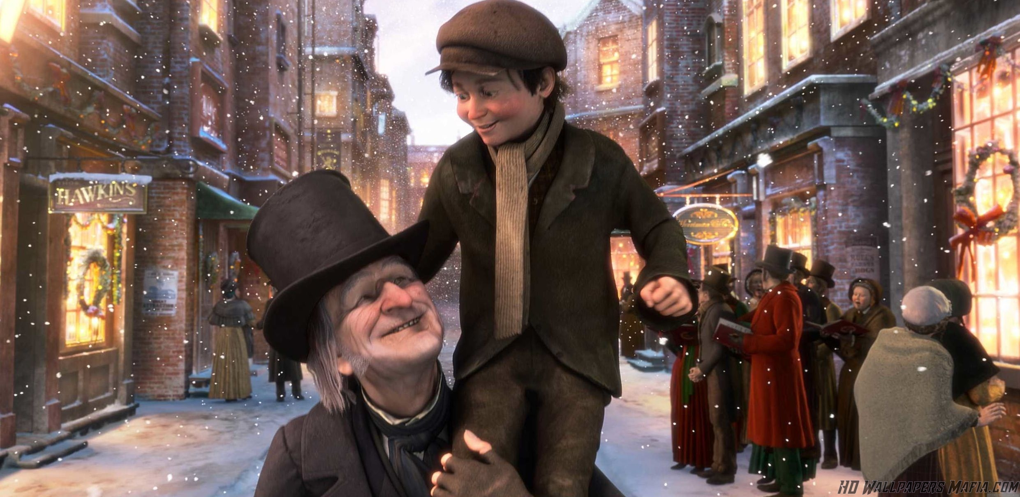
1: What is the precise terminology to describe a ‘sudden realisation’ by a character in a narrative? Is it: A: hypophora B: epiphany C: denouement
2: What adjective describes the kind of ‘idol’ Belle says has replaced her in Scrooge’s heart and affections?
3: “He had so heated himself with rapid walking in the fog and frost, this nephew of Scrooge's, that he was all in a glow; his face was ruddy and handsome; his eyes sparkled, and his breath smoked again.” Identify the five words used by Dickens here to associate Fred with the motif of fire, representing the warmth of his Christmas spirit.
4: What emanates from the head of the Ghost of Christmas Past?
5: Name two characters Scrooge is shown when he visits his past.

Slide 3
1: “A squeezing, wrenching, _____________ , scraping, ______________ , covetous old sinner!” Is it: A: grabbing / grasping B: clutching / grabbing C: grasping / clutching
2: From what is the throne made on which the ghost of Christmas Present sits?
3: When Scrooge enquires of Tiny Tim’s future, the Ghost of Christmas Present pronounces: “I see a __________ seat and a ___________ without an owner, carefully preserved.” What two words are missing from this quotation?
4: What are the names of the two children beneath the green, fur-trimmed robe of the Ghost of Christmas Present?
5: Speaking about Tiny Tim’s future, the ghost of Christmas Present tells Scrooge: “If these shadows remain unaltered by the future, … … …” Complete the quotation.

Slide 4
1: “There’s more of gravy than grave about you, whatever you are!” • Who is talking ? • To whom ? • What is meant by this ?
2: In stave 2, Scrooge is described as: “A _____________ child, ________________ by his friends.” Which two words are missing from the quotation? A: miserable / ignored B: solitary / neglected C: lonely / teased
3: Recall a simile used to describe Scrooge in Stave One.
4: What is the significance of the ‘trinkets’ on Marley’s chain?
5: Explain the symbolic significance that Fred’s breath “smoked”

Slide 5
1: “You may be an undigested bit of beef, a blot of mustard, a crumb of cheese, a fragment of an underdone potato.” • Who says this ? • To whom ? • What does it convey about his attitude at this point in the novella ?
2: Explain the significance of the colon in the novella’s opening sentence: “Marley was dead: to begin with.”
3: Explain how Fred is presented as the antithesis of Scrooge.
4: Jacob Marley warns Scrooge: “and, if that spirit goes not forth in life, it is ______________ to do so after death.” Is the missing word: A: ordered B: commanded C: condemned
5: Complete the quotation: “If they would rather die then they had better do it ____ ______ _____ ____ _________.”

Slide 6
1: The ghosts of Christmas Past, Present and Yet to Come arouse which three emotions in Scrooge: A: nostalgia, pity and fear B: joy, pain and anger C: sorrow, anger and pity
2: List three objects which are attached to the heavy chain dragged eternally by Jacob Marley.
3: In stave 2, Scrooge is described as: “A _____________ child, ________________ by his friends.” Which two words are missing from the quotation? A: miserable / ignored B: solitary / neglected C: lonely / teased
4: Scrooge has two epiphanies during Stave Two, while witnessing events from his past. Explain what they are as precisely as you can.
5: What are the names of the two children beneath the green, fur- trimmed robe of the Ghost of Christmas Present?

Slide 7
1: Which of the spirits is an androgynous figure?
2: Explain the symbolic significance of the phrase to describe Scrooge: "the cold within him froze his features."
3: Which character describes Scrooge as: "odious, stingy, hard, unfeeling"? Is it: A: Bob Cratchit B: Tiny Tim C: Mrs. Cratchit
4: Which figure from medieval art does the Ghost of Christmas Yet to Come closely resemble?
5: Complete the quotation, spoken by Scrooge: "Tell me I may sponge …."

Slide 8
1: In Stave One, Scrooge says: “Every idiot who goes about with Merry Christmas on his lips should be ... … …” what? Can you complete the quotation?
2: "Mankind was my __________. The common welfare was my ___________ ; charity, mercy, forbearance, and benevolence were all my __________. “ Is the missing word: A: concern B: business C: responsibility
3: List - in the order he is shown them - the FIVE vignettes of Scrooge’s past he is shown in Stave Two of the novella.
4: Explain in one sentence why Belle breaks off her engagement to Scrooge, embedding a quotation.
5: What does Scrooge send to Bob's house on Christmas Day?

Slide 9
1: Which of the spirits says nothing at all to Scrooge?
2: “I wear the chain … … …” Complete the quotation, adding as many words as you can.
3: Who is “brave in ribbons” ?
4: Recall two similes Scrooge uses to describe his transformed self in Stave Five of the novella.
5: Complete the quotation – a comment by Ebenezer Scrooge about the poor: “If they had rather die, … … …”

Slide 10
1: Is Scrooge a static or a dynamic character? How do you know?
2: When Fred toasts Scrooge as the “founder of the feast”, is he being: A: parsimonious B: charitable C: jovial
3: Bob Cratchit is emblematic of the Victorian working class man. Does this mean he is: A: a unique example B: an unusual example C: a typical example
4: Is fearful an appropriate word to describe Bob’s feelings towards Scrooge in Stave One of the novella?
5: Which spirit has the most disquieting effect on Scrooge ?

Slide 11
1: “A squeezing, wrenching, _____________ , scraping, ______________ , covetous old sinner!” Is it: A: grabbing / grasping B: clutching / grabbing C: grasping / clutching
2: What does the Ghost of Christmas Past hold in its hand?
3: When Scrooge enquires of Tiny Tim’s future, the Ghost of Christmas Present pronounces: “I see a __________ seat and a ___________ without an _______ , carefully __________.” What four words are missing from this quotation?
4: Who are described as “yellow, meagre, wolfish, scowling” ?
5: Explain the significance of the colon in the novella’s opening sentence: “Marley was dead: to begin with.”

Slide 12
1: “There’s more of gravy than grave about you, whatever you are!” • Who is talking ? • To whom ? • What is meant by this ?
2: In stave 2, Scrooge is described as: “A _____________ child, ________________ by his friends.” Which two words are missing from the quotation? A: miserable / ignored B: solitary / neglected C: lonely / teased
3: Explain the simile “Hard and sharp as flint” literally, metaphorically and symbolically.
4: Is jovial an appropriate word to describe Old Fezziwig ?
5: Explain the symbolic significance that Fred’s breath “smoked”

Slide 13
1: “He hoped the people saw him in the church … … and it might be pleasant to them to remember upon Christmas-day who made lame beggars walk and blind men see." • Who says this ? • To whom ? • What does it convey about the character being described ?
2: Explain the significance of the colon in the novella’s opening sentence: “Marley was dead: to begin with.”
3: Explain how Fred is presented as the antithesis of Scrooge.
4: Jacob Marley warns Scrooge: “and, if that spirit goes not forth in life, it is ______________ to do so after death.” Is the missing word: A: ordered B: commanded C: condemned
5: Complete the quotation: “If they would rather ____ then they had better do it ____ ______ _____ ____ _________.”

Slide 14
1: Name two characters Scrooge is shown when he visits his past.
2: What does the Ghost of Christmas Present hold in his hand?
3: “He had so ______himself with rapid walking in the fog and frost, this nephew of Scrooge's, that he was all in a ______ ; his face was ______ and handsome; his eyes _________ , and his breath ________ again.” Identify the missing five words used by Dickens to associate Fred with the motif of fire, representing the warmth of his Christmas spirit.
4: What is the precise terminology to describe a ‘sudden realisation’ by a character in a narrative? Is it: A: anaphora B: epiphany C: epizeuxis
5: What adjective describes the kind of ‘idol’ Belle says has replaced her in Scrooge’s heart and affections?

Slide 15
1: “A ______________ , wrenching, _____________ , scraping, ______________ , covetous old sinner!” Is it: A: grabbing / grasping / shrieking B: squeezing / clutching / grabbing C: squeezing / grasping / clutching
2: What is the symbolic significance of Scrooge describing himself as being: "happy as an angel" and "like a baby"?
3: When Scrooge enquires of Tiny Tim’s future, the Ghost of Christmas Present pronounces: “I see a __________ ______ a ___________ without an _______ , ______ _________.” What six words are missing from this quotation?
4: Which of the spirits is an androgynous figure?
5: Speaking about Tiny Tim’s future, the ghost of Christmas Present tells Scrooge: “If these shadows remain unaltered by the future, … … …” Complete the quotation.

Slide 16
1: Is altruistic a word you might use to describe Old Fezziwig ?
2: Does altruistic mean: A: selfish B: selfless C: self absorbed
3: Is it appropriate to describe Fred as the antithesis of Scrooge ?
4: Jacob Marley warns Scrooge: “and, if that _______ goes not forth in life, it is ______________ to do so after _________.” Are the three missing words: A: spirit / ordered / death B: spirit / commanded / death C: spirit / condemned / death
5: Complete the quotation: “This __________ is ___________ , this __________ is _______. Beware them both, and all of their ______________.”

Slide 17
1: To whom does this quotation refer? “a stale and shrivelled hand, like that of age, had pinched, and twisted them, and pulled them into shreds.”
2: Which character might best be described as being debilitated?
3: Explain how Fred is presented as the antithesis of Scrooge.
4: Scrooge might be described as parsimonious. Does this mean? A: he is unwilling to spend money or share resources B: he is unwilling to celebrate Christmas C: he is unwilling to change his behaviour
5: Complete the quotation: “If they would ______ ____ then they had _________ do it ____ ______ _____ ____ _________.”

Slide 18
1: In Stave One, Scrooge says: “Every idiot who goes about with Merry Christmas on his lips should be ... … …” what? Can you complete the quotation?
2: "Mankind was my __________. The common welfare was my ___________ ; charity, mercy, forbearance, and benevolence were all my __________. “ Is the missing word: A: concern B: business C: responsibility
3: Which character in Stave One is best described as condemned ?
4: Explain in one sentence why Belle breaks off her engagement to Scrooge, embedding a quotation.
5: Which character in Stave One is best described as penitent ?

Slide 19
1: Scrooge’s beneficence is evident in Stave Five. Does this mean: A: his transformation B: his generosity C: his sense of humour
2: “I wear the chain … … …” Complete the quotation, adding as many words as you can.
3: Which of the spirits might best be described as ominous ?
4: Recall two similes Scrooge uses to describe his transformed self in Stave Five of the novella.
5: Complete the quotation – a comment by Ebenezer Scrooge about the poor: “If they had rather die, … … …”

Slide 20
1: The ghosts of Christmas Past, Present and Yet to Come arouse which three emotions in Scrooge: A: nostalgia, pity and fear B: joy, pain and anger C: sorrow, anger and pity
2: Recall three ‘trinkets’ which are attached to Marley’s chain.
3: In stave 2, Scrooge is described as: “A _____________ child, ________________ by his _________.” Which three words are missing from the quotation? A: miserable / ignored / friends B: solitary / neglected / friends C: lonely / teased / friends
4: “Hard and sharp as flint”. Explain the significance of Dickens’ choice of “flint” in this simile and how it links to the motif of fire in the novella.
5: What do blind men’s dogs do when they see Scrooge approach?

Slide 21
1: Who is being described in this quotation ? “The happiness he gives, is quite as great as if it cost a fortune.” A: Scrooge in Stave Five B: Fred C: Old Fezziwig
2: “I wear the chain … … …” Complete the quotation, adding as many words as you can.
3: Which of the spirits might best be described as jovial ?
4: Recall two similes Scrooge uses to describe his transformed self in Stave Five of the novella.
5: Is pitiful an appropriate word to describe Tiny Tim ?

Slide 22
1: What is the symbolic significance of Scrooge describing himself as being: "happy as an angel" and "like a baby"?
2: How does Scrooge ‘punish’ Bob's lateness on Boxing Day?
3: Complete the simile: "Marley was as dead …“
4: Who does Scrooge claim was: "a good man of business"?
5: What kind of ‘father’ does Scrooge become to Tiny Tim? Is it: A: secondary B: special C: second D: secret

Slide 23
1: Which of the spirits is an irredeemable figure?
2: Explain the symbolic significance of the phrase to describe Scrooge: "the cold within him froze his features."
3: Which character describes Scrooge as: "odious, stingy, hard, unfeeling"? Is it: A: Bob Cratchit B: Tiny Tim C: Mrs. Cratchit
4: Is malignant an appropriate word to describe Fred’s nature?
5: Does the word malignant mean: A: friendly B: dishonest C: unfriendly

Slide 24
1: “You may be an undigested bit of beef, a blot of mustard, a crumb of cheese, a fragment of an underdone potato.” • Who says this ? • To whom ? • What does it convey about his attitude at this point in the novella ?
2: Is it better to be parsimonious or beneficent ? Why ?
3: Is altruistic a word you might use to describe Scrooge in Stave One?
4: Jacob Marley warns Scrooge: “and, if that _______ goes not forth in life, it is ______________ to do so after _________.” Are the three missing words: A: spirit / ordered / death B: spirit / commanded / death C: spirit / condemned / death
5: Complete the quotation: “If they would ______ _____ then they had _______ do it ____ ______ _____ ____ _________.”

Slide 25
1: Does the word ephemeral mean: A: lasting for a long time B: lasting for all time C: lasting for a short time
2: Which character might best be described as being debilitated?
3: Explain how Fred is presented as the antithesis of Scrooge.
4: Scrooge might be described as hostile in Stave 1. Does this mean? A: he is unwilling to give money to charity B: he is unkind towards Fred C: he is unfriendly and ill-mannered
5: Complete the quotation: “ I wear the chain … … …” using as many words as you can.

