Slide 1
Recalling Information
Learning Objectives: To be able to recall information; to select and deconstruct how a writer uses language to create meaning
How does Magwitch terrorise Pip?
Do Now
Notes:
LESSON 2

Slide 2
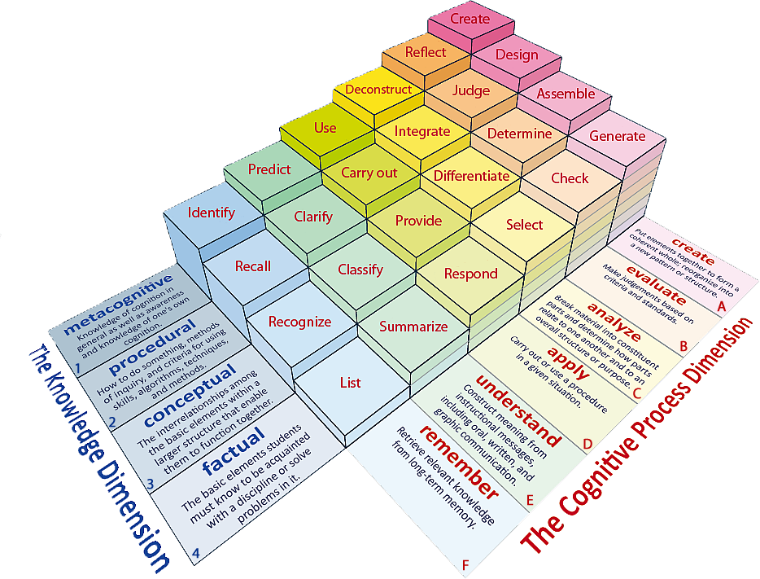
Learning Objectives: To be able to recall information; to select and deconstruct how a writer uses language to create meaning.
Learning Content

Slide 3
Learning Objectives: To be able to recall information; to select and deconstruct how a writer uses language to create meaning
Match the words to their definitions.
a thin, flat or rounded metal tool with rough surfaces for rubbing wooden or metal objects to make them smooth or to change their shape.
a person who makes and repairs iron objects and horseshoes.
physically disabled or injured, especially in the foot or leg so as to limp or walk with difficulty.
very great in amount or level, or extremely good.
Lamed Blacksmith Tremendous File
Unlocking Vocabulary

Slide 4
Learning Objectives: To be able to recall information; to select and deconstruct how a writer uses language to create meaning
Check your answers.
File: a thin, flat or rounded metal tool with rough surfaces for rubbing wooden or metal objects to make them smooth or to change their shape.
Blacksmith: a person who makes and repairs iron objects and horseshoes.
Lamed: physically disabled or injured, especially in the foot or leg so as to limp or walk with difficulty.
Tremendous: very great in amount or level, or extremely good.
Answers

Slide 5
Selecting Success in Reading
Learning Objectives: To be able to recall information; to select and deconstruct how a writer uses language to create meaning
To achieve high levels in reading, you need to be able to use PEA well.
What does PEA stand for?
POINT
EVIDENCE
ANALYSIS
Mastery

Slide 6
Achieving in Reading
Learning Objectives: To be able to recall information; to select and deconstruct how a writer uses language to create meaning
POINT: Give your answer to the question.
How does Magwitch terrorise Pip?
Mastery
Magwitch uses threats which are both physical and psychological to terrorise Pip.

Slide 7
Learning Objectives: To be able to recall information; to select and deconstruct how a writer uses language to create meaning
Achieving in Reading
EVIDENCE: Use a quotation from the novel to show what you have said is true.
Mastery

Slide 8
Selecting information
Learning Objectives: To be able to recall information; to select and deconstruct how a writer uses language to create meaning
Read through
Pages 4 and 5
Underline those words which show Pip is physically disorientated.
Reading Activity

Slide 9
Deconstructing
Learning Objectives: To be able to recall information; to select and deconstruct how a writer uses language to create meaning
Show that you understand the language used.
Mastery
Demonstrate that you are able to pick out a key word or phrase and examine its significance.
Look at the associated connotations of the word/phrase and how it answers your question

Slide 10
Deconstructing
Learning Objectives: To be able to recall information; to select and deconstruct how a writer uses language to create meaning
‘so giddy, I clung to him with both hands’
Mastery
The word “giddy” reveals how disorientated Pip feels.
The word “clung” indicates that Pip was desperately holding on to Magwitch.
Both words highlight how terrified Pip is.

Slide 11
Selecting and Deconstructing
Learning Objectives: To be able to recall information; to select and deconstruct how a writer uses language to create meaning
How does the writer show that Pip is scared?
P: Dickens makes Pip appear scared by…
E: He writes, “…”
A: This suggests that Pip is scared because…
The writer is trying to show that…
This makes the audience feel…
Mastery

Slide 12
Learning Objectives: To be able to recall prior learning; to select and deconstruct how a writer uses language to create meaning
Success in Reading
Can you remember what PEA stands for?
What makes a successful PEA paragraph?
Do Now
Clearly identify relevant points, including summary and synthesis of information from different sources or different places in the same text.
Support quotes with your main ideas or argument with a clear analysis
Comment on the effect on the reader!
Notes:
LESSON 3

Slide 13
Learning Objectives: To be able to recall prior learning; to select and deconstruct how a writer uses language to create meaning
Learning Content
Notes:
All, Most, Some

Slide 14
Learning Objectives: To be able to recall prior learning; to select and deconstruct how a writer uses language to create meaning
Match the words to their definitions.
Satisfactory or not bad.
Rough, irregular and uneven.
Softly spoken so it is nearly not heard.
Murmur Jagged Reasonable
Unlocking Vocabulary

Slide 15
Learning Objectives: To be able to recall prior learning; to select and deconstruct how a writer uses language to create meaning
Check your answers.
Reasonable: Satisfactory or not bad.
Jagged: Rough, irregular and uneven.
Murmur: Softly spoken so it is nearly not heard.
Answers

Slide 16
Context
Learning Objectives: To be able to recall prior learning; to select and deconstruct how a writer uses language to create meaning
This text was written almost 100 years after Great Expectations.
It is set in the American Deep South.
This extract also focuses on imagined fear; in this case, the rumours that surround a mysterious Boo Radley.
Contextual Information

Slide 17
Turn to page 6
Learning Objectives: To be able to recall prior learning; to select and deconstruct how a writer uses language to create meaning
Read the bold section.
Reading Activity
Why is Dill so interested in Boo Radley?

Slide 18
Questions 1 and 2 These questions are based on the first part of the text, up to go up and knock on the front door.
Learning Objectives: To be able to recall prior learning; to select and deconstruct how a writer uses language to create meaning
Mastery

Slide 19
Questions 1 and 2
Learning Objectives: To be able to recall prior learning; to select and deconstruct how a writer uses language to create meaning
1. How do we know that Jem’s description of Boo Radley in paragraph 5 is unlikely to be true?
I know Jem’s description of Boo is unlikely to be true because…
2. How does the writer use language to create a terrifying picture of Boo Radley in this paragraph?
The writer uses…
Mastery

Slide 20
Learning Objectives: To be able to recall prior learning; to select and deconstruct how a writer uses language to create meaning
What can you remember about To Kill a Mocking Bird?
Do Now
Notes:
LESSON 4

Slide 21
Learning Objectives: To be able to recall prior learning; to select and deconstruct how a writer uses language to create meaning
Learning Contnet

Slide 22
Learning Objectives: To be able to recall prior learning; to select and deconstruct how a writer uses language to create meaning
Match the words to their definitions.
To talk about or look at someone or something in an unkind way that shows you do not respect or approve of them.
To enter a place suddenly or secretly often in order to steal something.
An informal word for people.
Removes (something) by digging or cutting.
Gouges Sneered Raid Folks
Unlocking Vocabulary

Slide 23
Learning Objectives: To be able to recall prior learning; to select and deconstruct how a writer uses language to create meaning
Check your answers:
Sneered: To talk about or look at someone or something in an unkind way that shows you do not respect or approve of them.
Raid: To enter a place suddenly or secretly often in order to steal something.
Folks: An informal word for people.
Gouges: Removes (something) by digging or cutting.
Answers

Slide 24
Learning Objectives: To be able to recall prior learning; to select and deconstruct how a writer uses language to create meaning
Q3. How does Dill succeed in making Jem agree to touch the Radley’s front door?
Q4. Scout is Jem’s younger sister and she is also the narrator.
Reread the two paragraphs from Jem wanted Dill to know up to confronted by the Radley place.
Scout understands her brother very well. Explain how we know this.
When answering these questions you must remember to use PEA!
Mastery

Slide 25
Questions 5 and 6
Learning Objectives: To be able to recall prior learning; to select and deconstruct how a writer uses language to create meaning
When answering these questions you must remember support your answer with evidence from the text.
Mastery

Slide 26
Learning Objectives: To be able to recall prior learning; to select and deconstruct how a writer uses language to create meaning
Q.5 Reread the final paragraph which is the end of this chapter.
How successful is it as a chapter ending?
You should comment on:
The way this paragraph contrasts with the one before
The way the house is described
How it provides a satisfying ending
Mastery

Slide 27
Learning Objectives: To be able to recall prior learning; to select and deconstruct how a writer uses language to create meaning
6.Both texts are about children who are frightened of adults.
Pick out similarities and differences in the way the writer describes the children’s fears.
Checking Understanding
Similarities | Differences

