Slide 1
Learning Objectives: To analyse and respond to the writer’s use of language.
Match the words to their definitions.
Feeling as if you might vomit.
The feeling or state of having no hope.
Something that is required or compulsory often by law.
Brief and using few words.
Mandatory Terse Nauseous Grimness
Unlocking Vocabulary
Notes:
LESSON 5

Slide 2
Learning Objectives: To analyse and respond to the writer’s use of language.
Check your answers:
Nauseous: Feeling as if you might vomit.
Grimness: The feeling or state of having no hope.
Mandatory: Something that is required or compulsory often by law.
Terse: Brief and using few words.
Answers
Notes:
LESSON 5

Slide 3
PREDICT: What do you think the story will be about based on the selected words?
Mandatory
Claustrophobic
Tightly
Terse
Nauseous
Grimness
Buzzards
Do Now

Slide 4
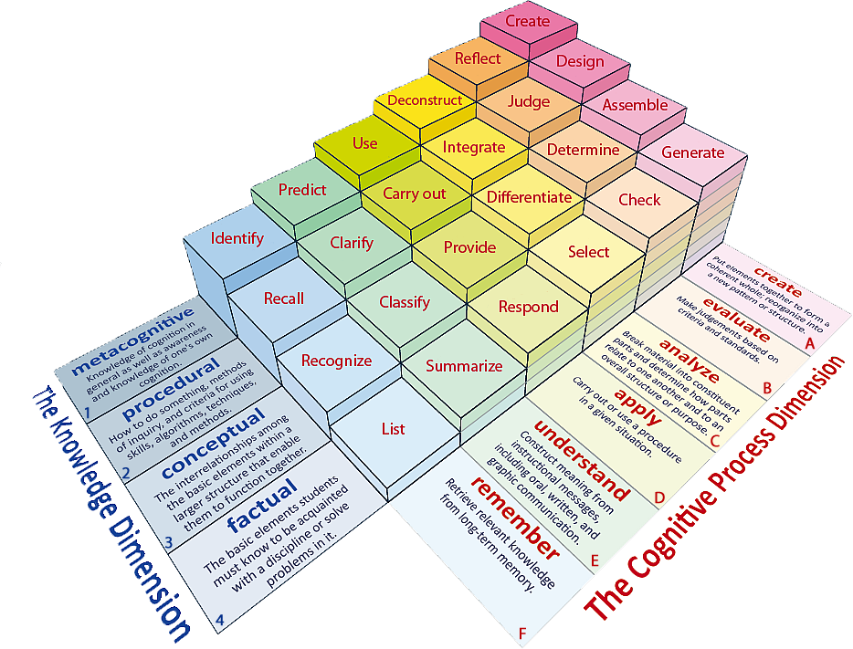
Learning Objective: To analyse and respond to the writer’s use of language.
Learning Content

Slide 5
Learning Objectives: To analyse and respond to the writer’s use of language.
Clarify: As we read the extract, consider the following points.
Reading Activity
What is the event being described?
How are people being treated?
How is a sense of danger being created?

Slide 6
Learning Objectives: To analyse and respond to the writer’s use of language.
QUESTION: How is language used by the writer to create mood and atmosphere?
Literary Devices?
At one o’clock, we head for the square. Attendance is mandatory unless you are at death’s door. This evening, officials will come around and check to see if this is the case. If not, you’ll be imprisoned.
It’s too bad, really, that they hold the reaping in the square – one of the few places in District 12 that can be pleasant. The square’s surrounded by shops, and on public market days, especially if there’s good weather, it has a holiday feel to it. But today, despite the brilliant banners hanging on the buildings, there’s an air of grimness. The camera crews, perched like buzzards on rooftops, only add to the effect.
Mastery
Effective word choices?

Slide 7
Learning Objectives: To analyse and respond to the writer’s use of language.
How is language used by the writer to create mood and atmosphere?
P: The writer creates …
E: She states, “…”
A: This suggests that …
The writer is trying to show that…
The word “______” highlights …
Mastery

Slide 8
Learning Objectives: To analyse and respond to the writer’s use of language.
Which part of the text do you think is the most effective in creating the mood & atmosphere?
Remember: You need to justify your point.
Checking Understanding

Slide 9
Learning Objectives: To evaluate and provide opinions of a text.
Can you climb the ladder?
How many sentence starters can you think of that can be used to show your opinion?
Do Now
I think…
Notes:
LESSON 6

Slide 10
Learning Objective: To evaluate and provide opinions of a text.
Learning Content

Slide 11
Learning Objectives: To evaluate and provide opinions of a text.
Write definitions for the following key vocabulary:
Fact:
Opinion:
Evaluate:
Unlocking Vocabulary

Slide 12
Learning Objectives: To evaluate and provide opinions of a text.
The Dursleys are not good parental figures.
Mastery

Slide 13
Learning Objectives: To evaluate and provide opinions of a text.
The Dursleys are not good parental figures.
FOR | AGAINST
“the cupboard under the stairs was full of them, and that was where he slept.” | “It looked as though Dudley had got the new computer he wanted”
Mastery

Slide 14
Learning Objectives: To evaluate and provide opinions of a text.
The Dursleys are not good parental figures.
Do you agree with this statement?
P: I believe…
E: The text says, “…”
A: This shows that …
The word “______” implies …
The writer wants us to think…
Mastery

Slide 15
A Midsummer Night’s Dream by William Shakespeare.
1.
LO: To introduce the playwright, William Shakespeare.
ST: I can have an understanding of Elizabethan life.

Slide 16
Starter: So, what do you know about William Shakespeare and life in Elizabethan England?
DO NOW!
Create a mind map of what you already know about William Shakespeare or life in Elizabethan Engliand.

Slide 17
Task: Use the word document on Shakespeare, his life, plays and Elizabethan life in 16th Century England. You must collect important information so that you can produce a fact file whole page poster in your book.
MASTERY

