Slide 1
An Inspector calls by JB Priestley
LO: To revise quotations and plot in preparation for the mock exams.
ST: I can answer with confidence.

Slide 2
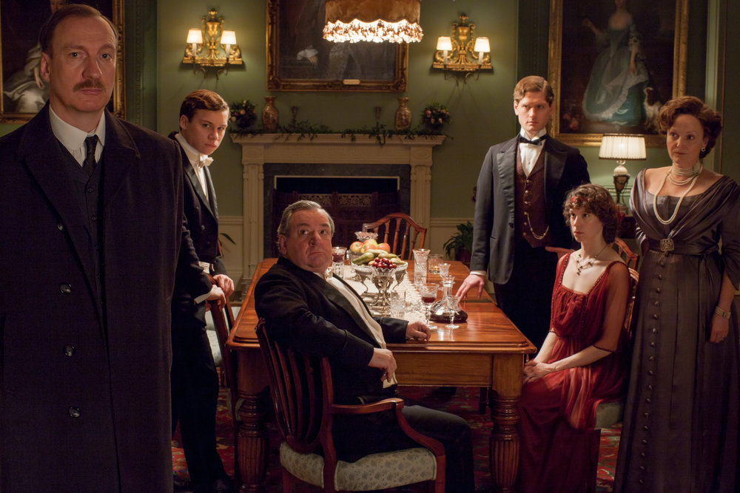
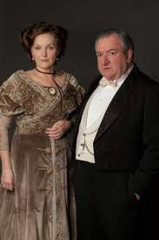
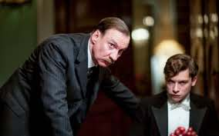
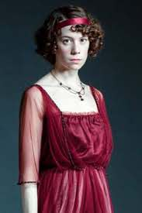
Task 1: In no more than 50 words summarise the play!
Task 2: Name all the characters and give a brief overview of their link in the chain of events.
An Inspector Calls

Slide 3
Act 1 Identify the speaker:
1 “ a man has to mind his own business and look after himself and his own.”
2. “ This young woman, Eva Smith, was a bit out of the ordinary”
3. “But these girls aren’t cheap labour – they’re people”
4. “She’d had a lot to say – far too much – so she had to go”
“so long as we behave ourselves, don’t get into the police court or start a scandal – eh?”
“It’s my duty to ask questions”
“I don’t come into this suicide business”
Identify the person(s) ‘to whom’ this comment refers:

Slide 4
Act 2 Identify the speaker:
1”You mustn’t try to build up a kind of wall between us and that girl”
2. “ Nothing but morbid curiosity”
4. “Yes, I think it was simply a piece of gross impertinence”
3. “You see, we have to share something. If there’s nothing else, we’ll have to share our guilt”
“It’s bound to be unpleasant and disturbing”
“I rather respect you more than I’ve ever done before.”
“And now you’ve made up your mind I must obviously be a selfish, vindictive creature”
Identify the person(s) ‘to whom’ this comment refers:

Slide 5
Act 3 Identify the speaker:
1”I wasn’t in love with her or anything – but I liked her – she was pretty and a good sport”
2. “ We are members of one body. We are responsible for each other.”
4. “Well, I must say this manner was quite extraordinary: so – so rude – and assertive.”
3. “The point is, you don’t seem to have learnt anything”
“I suppose we’re all nice people now.”
Identify the person(s) ‘to whom’ this comment refers:
“Where did you get fifty pounds from?”
“You don’t understand anything. You never did.”

Slide 6
