Slide 1
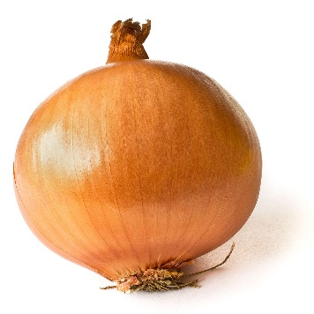
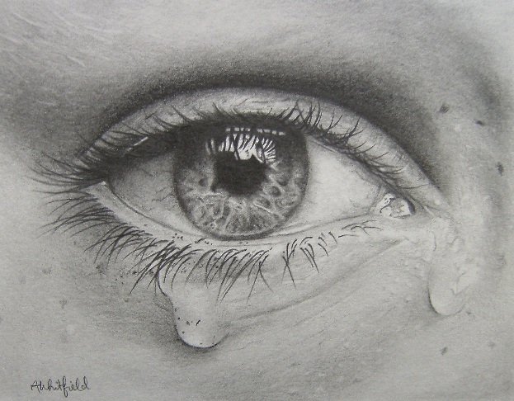
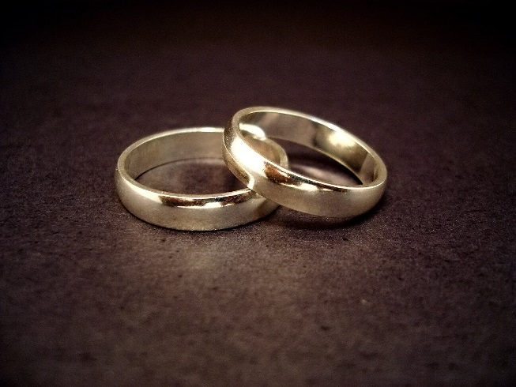
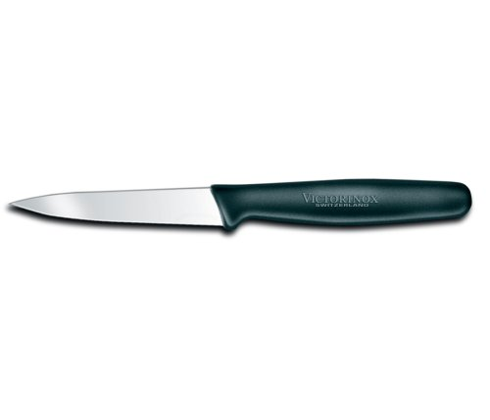
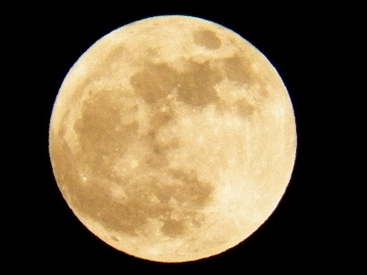
Valentine—Round 1
‘cling to your knife’
‘It is a moon wrapped in brown paper’
‘It will blind you with tears’
‘Its platinum loops shrink to a wedding ring’

Slide 2
Valentine—Round 2
‘cling to your _______’
‘It is a _______ wrapped in brown paper’
‘It will blind you with ______’
‘Its platinum loops shrink to a ________ _____’

Slide 3
Valentine—Round 3
‘cling to your _______’
‘It is a _______ wrapped in ______ ________’
‘It will ______ you with ______’
‘Its __________ ______ shrink to a ________ _____’

Slide 4
Valentine—Round 4

Slide 5
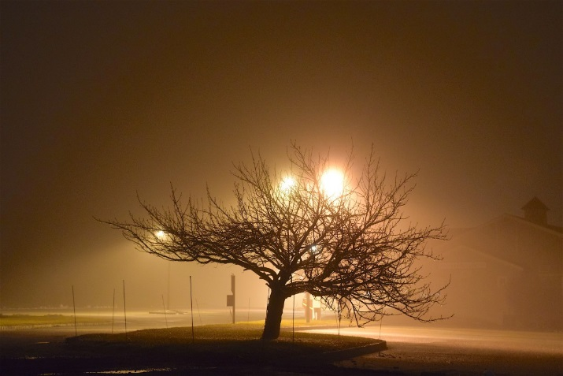
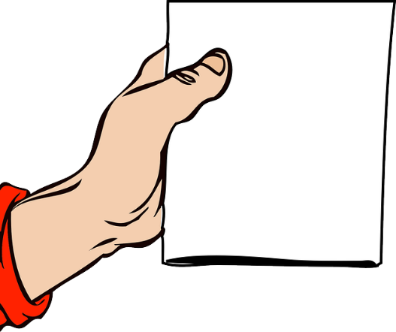
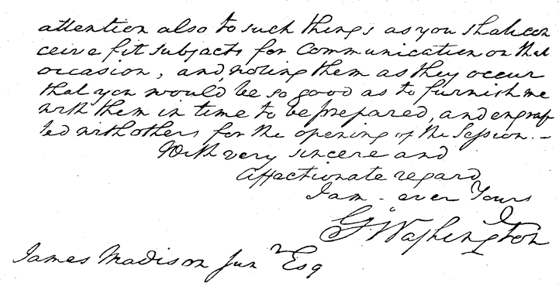
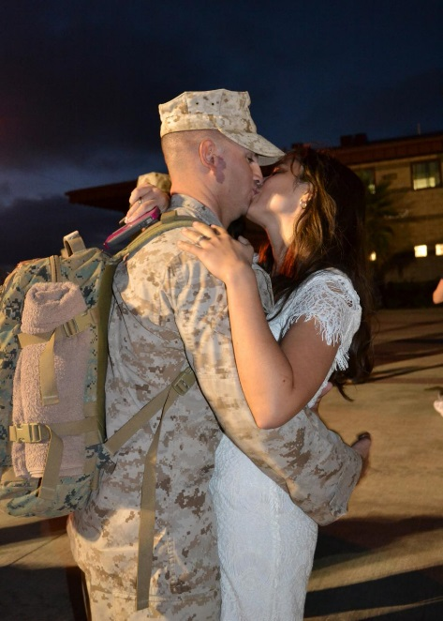
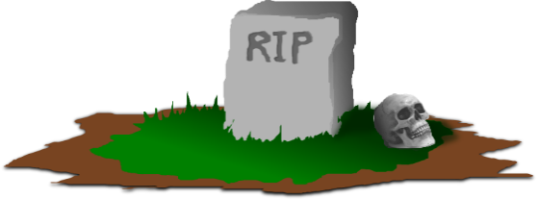
Wife in London—Round 1
Regret to inform you…
‘She sits in the tawny vapour’
‘flashed news is in her hand’
‘His hand, whom the worm now knows’
‘page-full of his hoped return’

Slide 6
Wife in London—Round 2
Regret to inform you…
‘She sits in the tawny _______’
‘flashed news is in her ______’
‘His hand, whom the ______ now knows’
‘page-full of his hoped _______’

Slide 7
Wife in London—Round 3
Regret to inform you…
‘She _____ in the _______ _______’
‘flashed _____ is in her ______’
‘His _____, whom the ______ now _______’
‘page-full of _____ _______ _______’

Slide 8
Wife in London—Round 4
Regret to inform you…

Slide 9
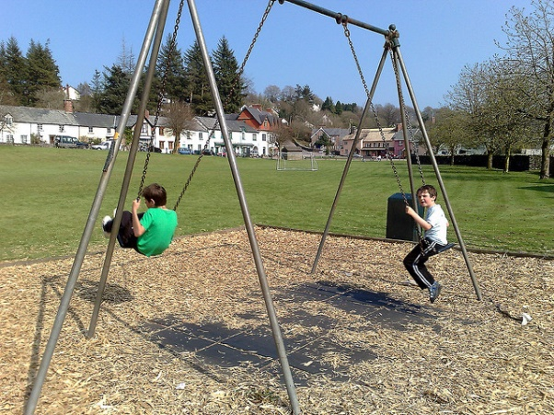
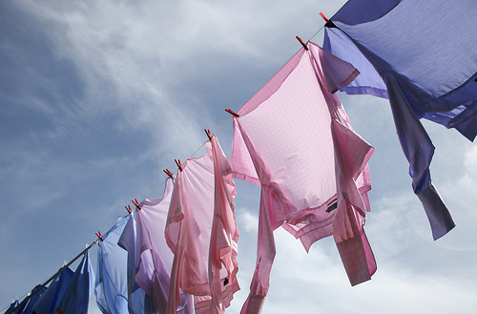
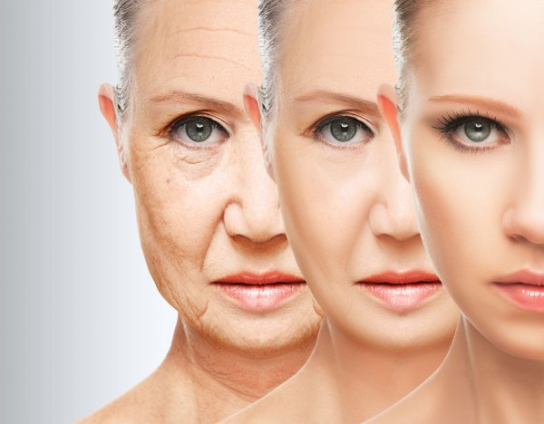
Afternoons—Round 1
‘Young mothers assemble at swing and sandpit’
‘an estateful of washing’
‘their beauty has thickened’
‘pushing them to the side of their own lives’

Slide 10
Afternoons—Round 2
‘Young mothers assemble at ______ and _________’
‘an estateful of _________’
‘their beauty has __________’
‘pushing them to the _____ of their own _______’

Slide 11
Afternoons—Round 3
‘Young _______ assemble at ______ and _________’
‘an _________ of _________’
‘their _______ has __________’
‘________ them to the _____ of their own _______’

Slide 12
Afternoons—Round 4

