Slide 1
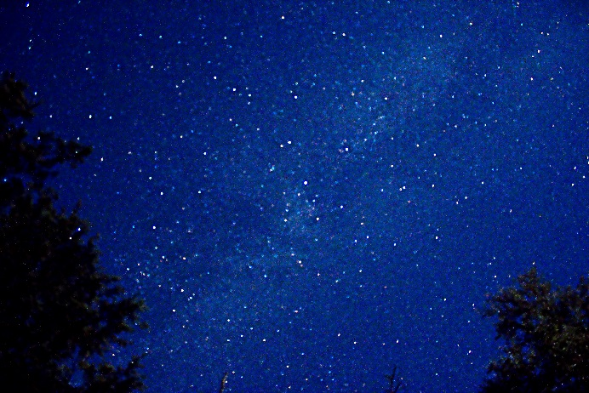
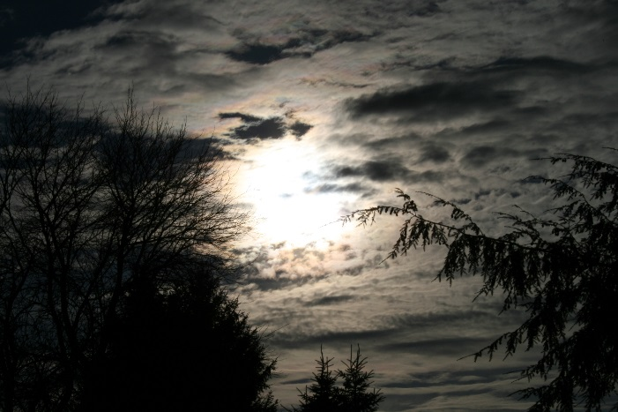
She Walks in Beauty—Round 1
‘A heart whose love is innocent!’
‘cloudless climes and starry skies’
‘all that’s best of dark and bright’
‘the smiles that win, the tints that glow’

Slide 2
She Walks in Beauty—Round 2
‘A _______ whose love is innocent!’
‘cloudless climes and ______ ______’
‘all that’s best of _____ and _______’
‘the _______ that win, the ______ that glow’

Slide 3
She Walks in Beauty—Round 3
‘A _______ whose ______ ___ __________!’
‘__________ _______ and ______ ______’
‘all that’s ______ of _______ ____ _______’
‘the _______ that ____, the ______ that ______’

Slide 4
She Walks in Beauty—Round 4

Slide 5
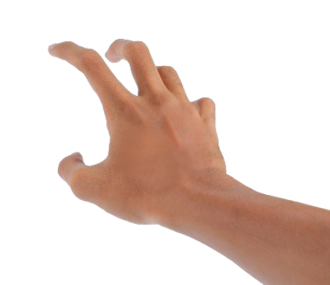
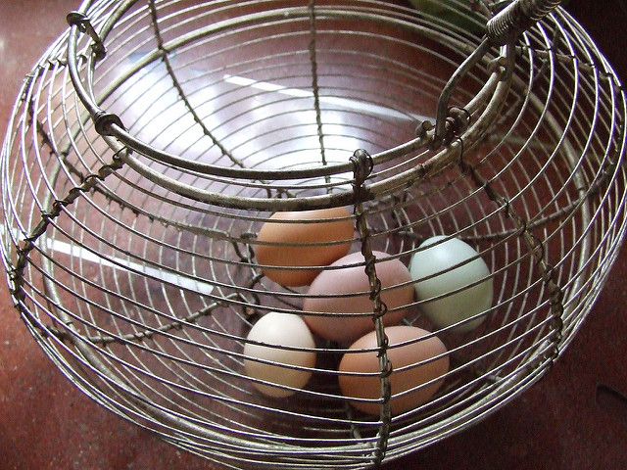
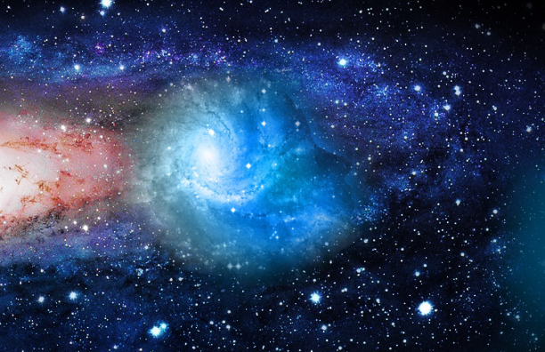
Living Space—Round 1
‘nails clutch at open seams’
‘eggs in a wire basket’
‘dark edge of a slanted universe’
‘just not enough straight lines’

Slide 6
Living Space—Round 2
‘______ _______ at open seams’
‘eggs in a _____ basket’
‘dark edge of a slanted ________’
‘just not enough straight ______’

Slide 7
Living Space—Round 3
‘______ _______ at open _______’
‘______ in a _____ ________’
‘dark _____ of a slanted ________’
‘just not enough ________ ______’

Slide 8
Living Space—Round 4

Slide 9
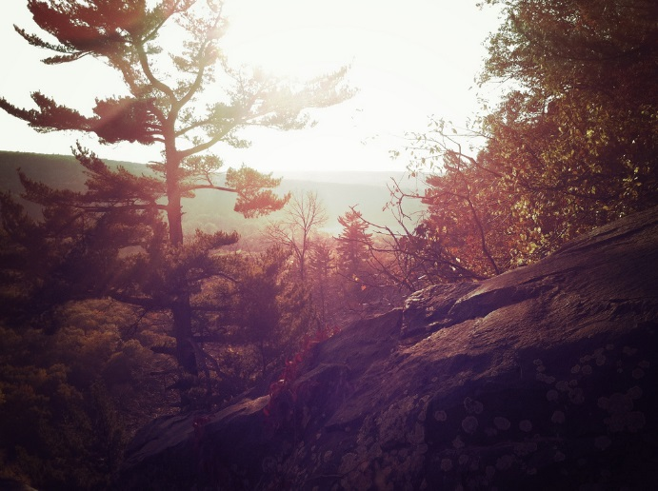
As Imperceptibly as Grief—Round 1
‘Our Summer made her light escape/Into the Beautiful’
‘Summer lapsed away’
‘A Quietness distilled’
‘As Guest, that would be gone’

Slide 10
As Imperceptibly as Grief—Round 2
‘Our Summer made her light ______/Into the __________’
‘_______ lapsed away’
‘A ________ distilled’
‘As ______, that would be _______’

Slide 11
As Imperceptibly as Grief—Round 3
‘Our ________ made her ______ ______ /Into the __________’
‘_______ lapsed ______’
‘A ________ distilled’
‘As ______, that would be _______’

Slide 12
As Imperceptibly as Grief—Round 4

Slide 13
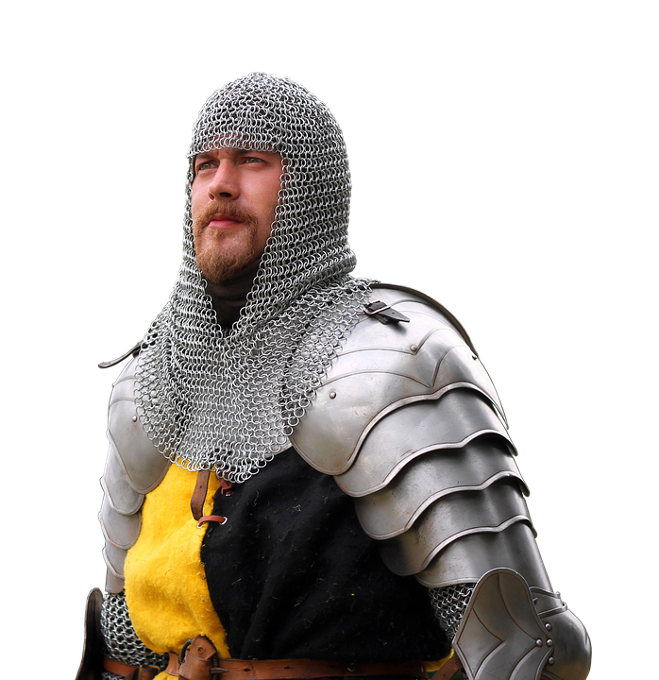
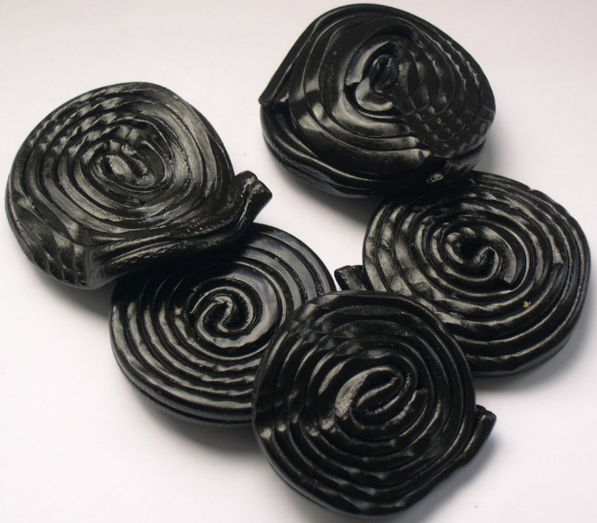
Cozy Apologia—Round 1
‘When has the ordinary ever been news?’
‘sure as shooting arrows to the heart’
‘chain mail glinting, to set me free’
‘thin as licorice and as chewy’

Slide 14
Cozy Apologia—Round 2
‘When has the ordinary ever been ______?’
‘sure as shooting _______ to the heart’
‘chain _____ glinting, to set me _____’
‘thin as _________ and as chewy’

Slide 15
Cozy Apologia—Round 3
‘When has the ________ ever been ______?’
‘sure as ________ _______ to the heart’
‘chain _____ ________, to set me _____’
‘thin as _________ and as ______’

Slide 16
Cozy Apologia—Round 4

