Slide 1
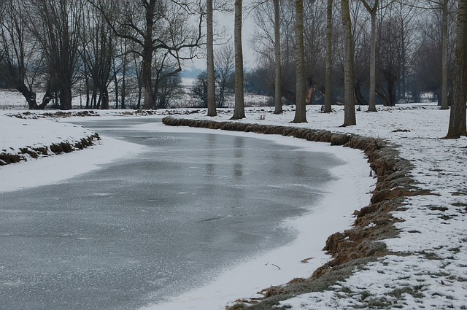
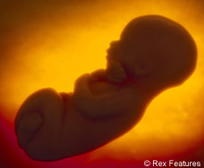
The Manhunt—Round 1
‘the damaged, porcelain collar-bone’
‘the foetus of metal beneath his chest’
‘to a sweating, unexploded mine buried deep in his mind’
‘the frozen river which ran through his face’

Slide 2
The Manhunt—Round 2
‘the damaged, _________ collar-bone’
‘the foetus of ______ beneath his _______’
‘to a sweating, unexploded _____ buried deep in his _______’
‘the frozen _____ which ran through his ______’

Slide 3
The Manhunt—Round 3
‘the ________, _________ collar-bone’
‘the _______ of ______ beneath his _______’
‘to a sweating, ________ _____ buried deep in his _______’
‘the _______ _____ which ____ through his ______’

Slide 4
The Manhunt—Round 4

Slide 5
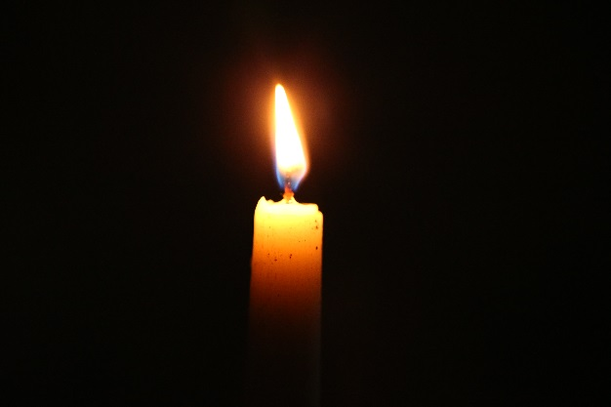
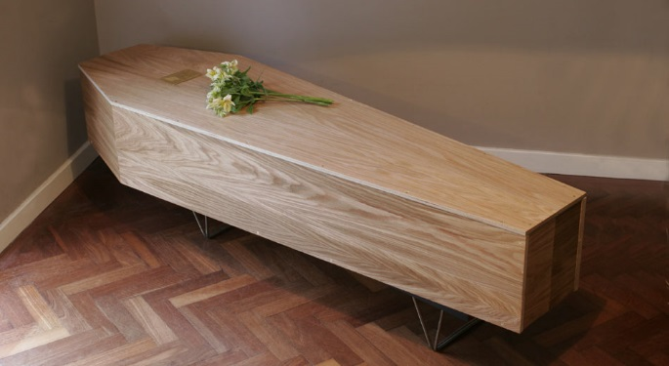
Sonnet 43—Round 1
‘I shall but love thee better after death.’
‘I love thee to the depth and breadth and height’
‘to the level of everyday’s most quiet need, by sun and candlelight’
‘with my childhood’s faith’

Slide 6
Sonnet 43—Round 2
‘I shall but love thee better after _____.’
‘I love thee to the ______ and breadth and height’
‘to the level of everyday’s most quiet need, by _____ and ___________’
‘with my childhood’s _____’

Slide 7
Sonnet 43—Round 3
‘I shall but _____ thee _______ after _____.’
‘I _____ thee to the ______ and _______ and height’
‘to the level of everyday’s most ______ need, by _____ and ___________’
‘with my __________ _____’

Slide 8
Sonnet 43—Round 4

Slide 9
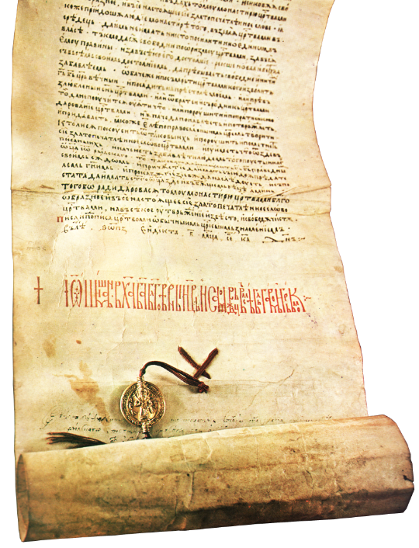
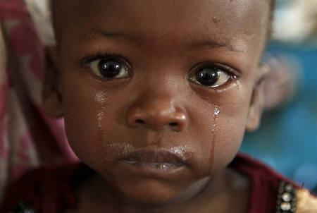
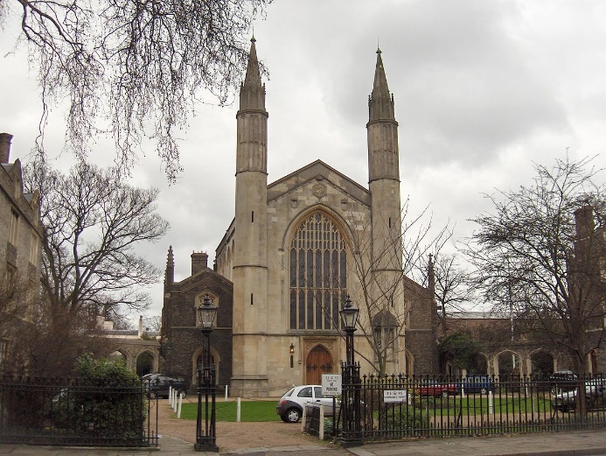
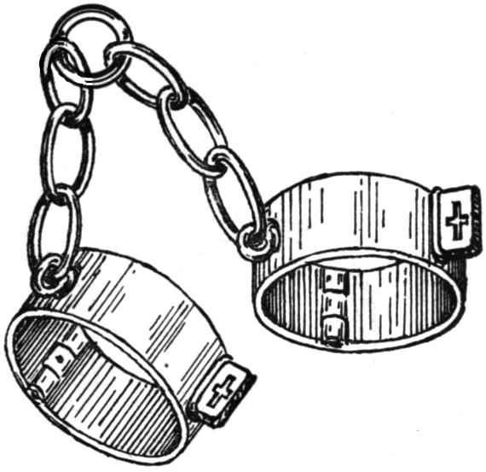
London—Round 1
‘marks of weakness, marks of woe’
‘mind-forg’d manacles’
‘Every black’ning Church appalls’
‘I wander thro’ each charter’d street’

Slide 10
London—Round 2
‘marks of weakness, marks of _____’
‘mind-forg’d ________’
‘Every black’ning ________ appalls’
‘I wander thro’ each ________ street’

Slide 11
London—Round 3
‘marks of _________, marks of _____’
‘_______-forg’d ________’
‘Every __________ ________ appalls’
‘I _______ thro’ each ________ ________’

Slide 12
London—Round 4

Slide 13
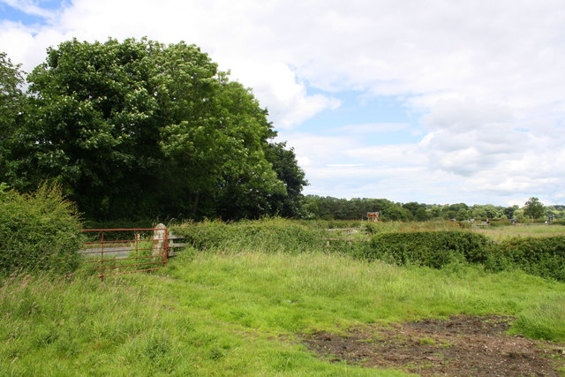
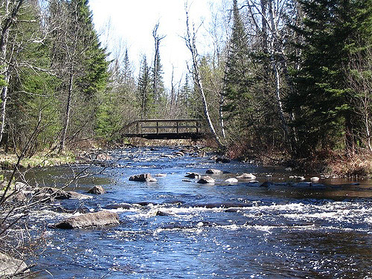
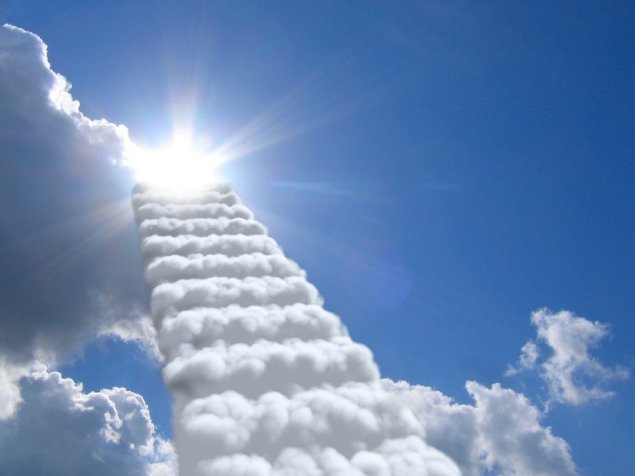
The Soldier—Round 1
‘some corner of a foreign field/That is for ever England.’
‘Washed by rivers, blest by suns of home.’
‘And think, this heart, all evil shed away’
‘In hearts at peace, under an English heaven.’

Slide 14
The Soldier—Round 2
‘some corner of a foreign ______/That is for ever ________.’
‘Washed by _______, blest by suns of _______.’
‘And think, this ________, all evil shed away’
‘In hearts at peace, under an English _________.’

Slide 15
The Soldier—Round 3
‘some corner of a _________ ______/That is for ever ________.’
‘Washed by _______, blest by ______ of _______.’
‘And think, this ________, all _____ shed away’
‘In hearts at _______, under an English _________.’

Slide 16
The Soldier—Round 4

