Slide 1
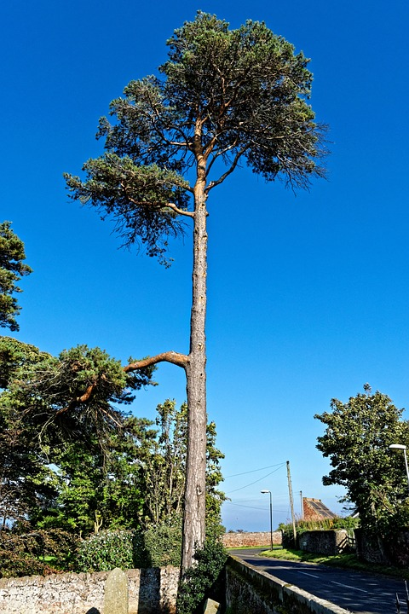
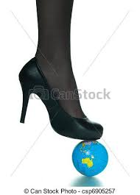
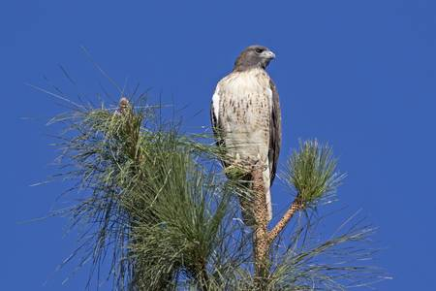
Memorising Quotations—Round 1
I sit in the top of the wood, my eyes closed.
The convenience of the high trees!
Now I hold Creation in my foot
The allotment of death.

Slide 2
Memorising Quotations—Round 2
I sit in the ____ of the wood, my eyes _____.
The _________ of the high trees!
Now I hold _______ in my foot
The ________of death.

Slide 3
Memorising Quotations—Round 3
I sit in the ____ of the ____, my eyes _____.
The _________ of the ____ ______!
Now I hold _______ in my ________
The ________of ______.

Slide 4
Memorising Quotations—Round 4

Slide 5
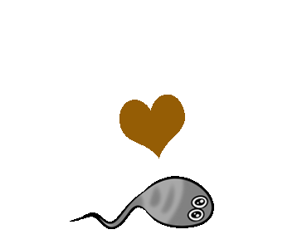
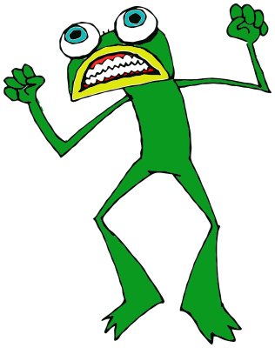
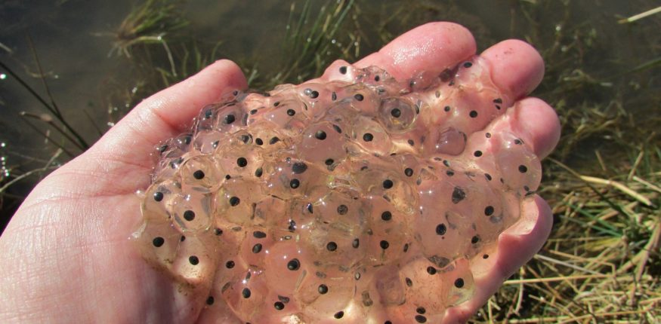
Memorising Quotations—Round 1
…watch and wait until the fattening dots burst into nimble-swimming tadpoles
Best of all was the warm, thick slobber of frogspawn
The great slime kings were gathered there for vengeance
Angry frogs invaded the flax-dam

Slide 6
Memorising Quotations—Round 2
…watch and wait until the _________ dots burst into nimble-swimming ________
Best of all was the ____, thick slobber of _________
The great slime _____ were gathered there for ______
____ frogs invaded the flax-dam

Slide 7
Memorising Quotations—Round 3
…______ and _____ until the _________ dots burst into ______-swimming ________
____ of all was the ____, thick ______ of _________
The _____ slime _____ were _____ there for ______
____ frogs ______ the flax-______

Slide 8
Memorising Quotations—Round 4

Slide 9
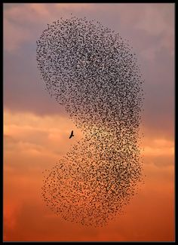
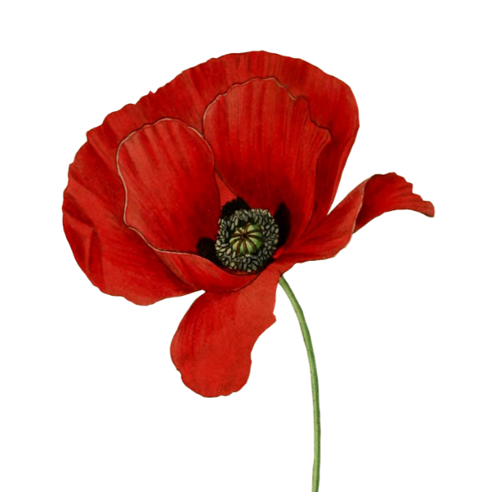
Memorising Quotations—Round 1
Close bosom-friend of the maturing sun
And gathering swallows twitter in the skies
Where are the songs of spring?
Drows’d with the fume of poppies

Slide 10
Memorising Quotations—Round 2
Close bosom-_____ of the maturing sun
And gathering _______ twitter in the skies
Where are the songs of _____?
Drows’d with the fume of _____

Slide 11
Memorising Quotations—Round 3
____ bosom-_____ of the ________ sun
And _______ _______ twitter in the _______
Where are the _______ of _____?
______ with the fume of _____

Slide 12
Memorising Quotations—Round 4

Slide 13
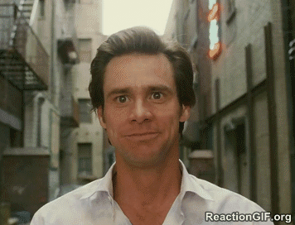
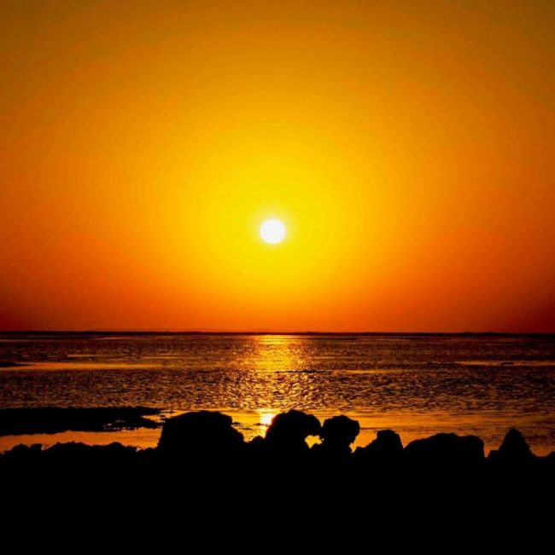
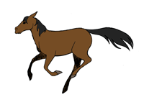
Memorising Quotations—Round 1
To me, it was a time of rapture
Proud and exulting, like an untir’d horse
The orange sky of evening died away
We hiss’d along the polished ice

Slide 14
Memorising Quotations—Round 2
To me, it was a time of _______
Proud and ______, like an untir’d horse
The ______ sky of evening died away
We hiss’d along the ______ ice

Slide 15
Memorising Quotations—Round 3
To ____, it was a time of _______
_____ and ______, like an untir’d _____
The ______ sky of _____ ____ away
We ____ along the ______ ice

Slide 16
Memorising Quotations—Round 4

