Slide 1
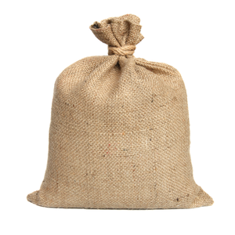
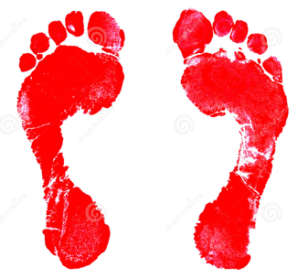
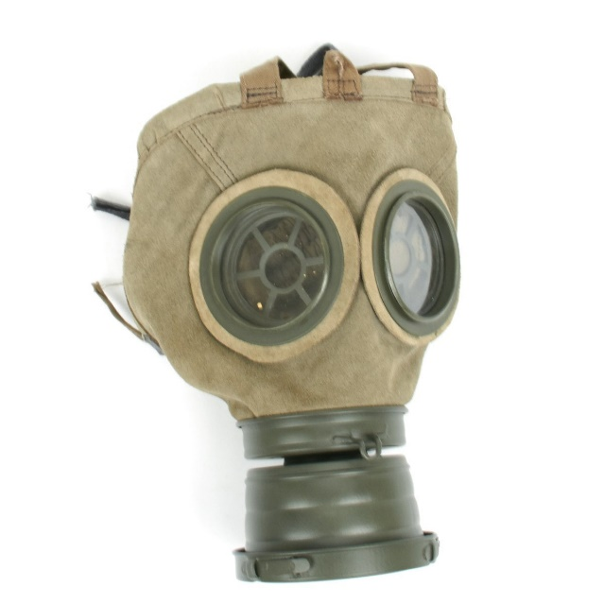
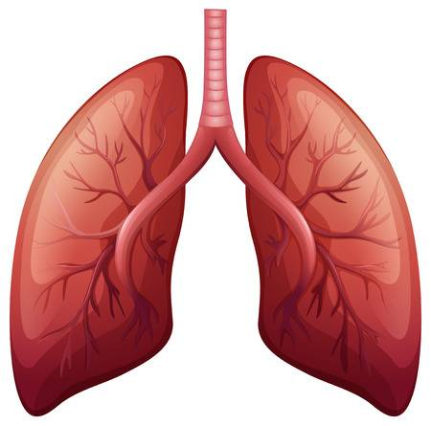
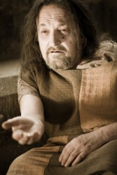
Dulce et Decorum Est—Round 1
‘Many had lost their boots, but marched on, blood-shod’
‘Fitting the clumsy helmets just in time’
‘the blood come gargling from froth-corrupted lungs’
‘Bent double, like old beggars under sacks’

Slide 2
Dulce et Decorum Est—Round 2
‘Many had lost their _____, but marched on, _______’
‘Fitting the ______ ______ just in time’
‘the _____ come gargling from froth-corrupted _____’
‘Bent ____, like old _____ under sacks’

Slide 3
Dulce et Decorum Est—Round 3
‘____ had lost their _____, but ______ on, _______’
‘_____ the ______ ______ just in ____’
‘the _____ come _____ from froth-______ _____’
‘Bent ____, like ____ _____ under ____’

Slide 4
Dulce et Decorum Est—Round 4

Slide 5
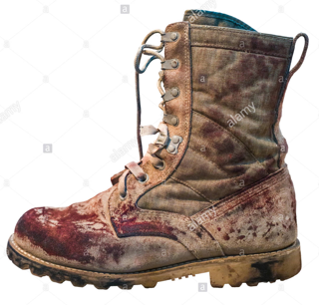
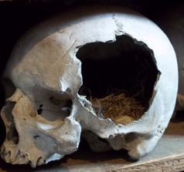
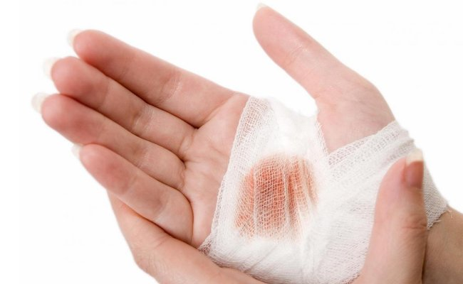
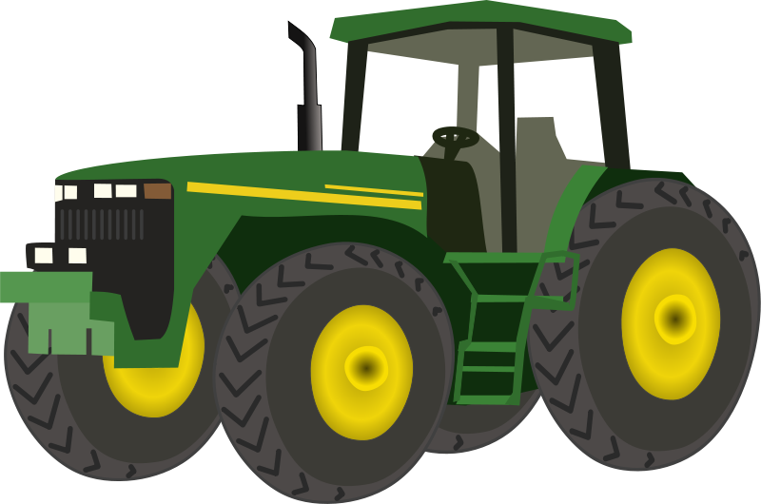
Mametz Wood—Round 1
‘For years afterwards the farmers found them – the wasted young’
‘The broken birds-egg of a skull’
‘Like a wound working a foreign body to the surface of the skin’
‘In boots that outlasted them’

Slide 6
Mametz Wood—Round 2
‘For years afterwards the _____ found them – the wasted _____’
‘The broken _____-egg of a _____’
‘Like a ______ working a foreign body to the surface of the ____’
‘In _____ that outlasted them’

Slide 7
Mametz Wood—Round 3
‘For _____ afterwards the _____ found them – the ______ _____’
‘The ______ _____-_____ of a _____’
‘Like a ______ working a _______ body to the ______ of the ____’
‘In _____ that _______ them’

Slide 8
Mametz Wood—Round 4

Slide 9
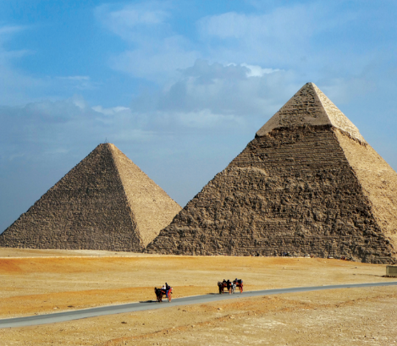
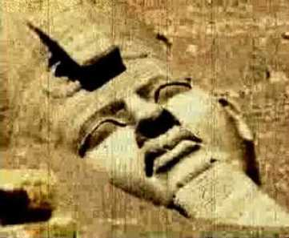
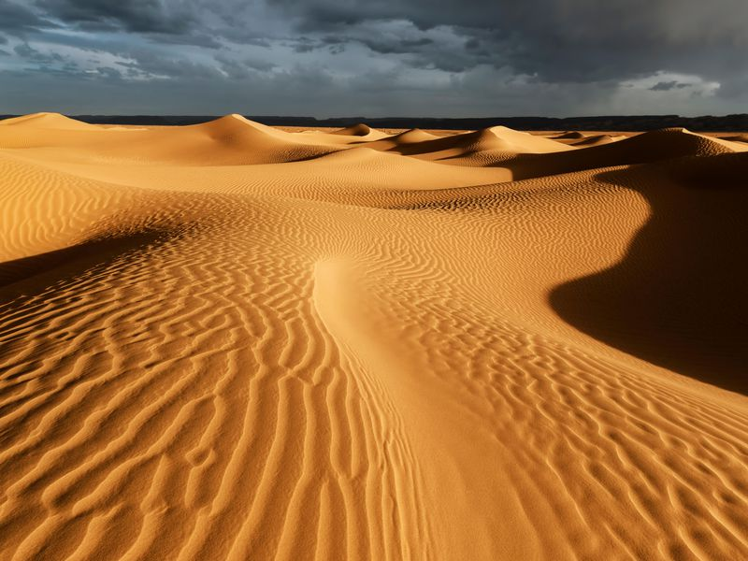
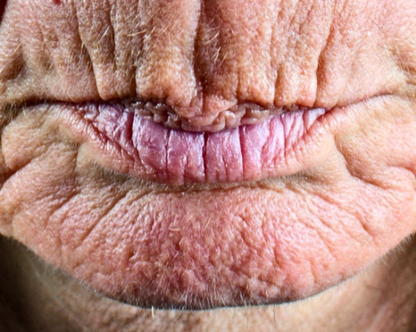
Ozymandias—Round 1
‘I met a traveller from an antique land’
‘Half sunk, a shattered visage lies’
‘Frown, and wrinkled lip, and sneer of cold command’
‘Boundless and bare, the lone and level sands stretch far away’

Slide 10
Ozymandias—Round 2
‘I met a _____ from an ______ land’
‘Half _____, a shattered ______ lies’
‘_____, and wrinkled lip, and _____ of cold command’
‘________ and bare, the lone and level _____ stretch far away’

Slide 11
Ozymandias—Round 3
‘I _____ a _____ from an ______ _____’
‘Half _____, a _______ ______ lies’
‘_____, and _____ lip, and _____ of cold ________’
‘________ and bare, the _____ and ______ _____ stretch far _____’

Slide 12
Ozymandias—Round 4

