Slide 1
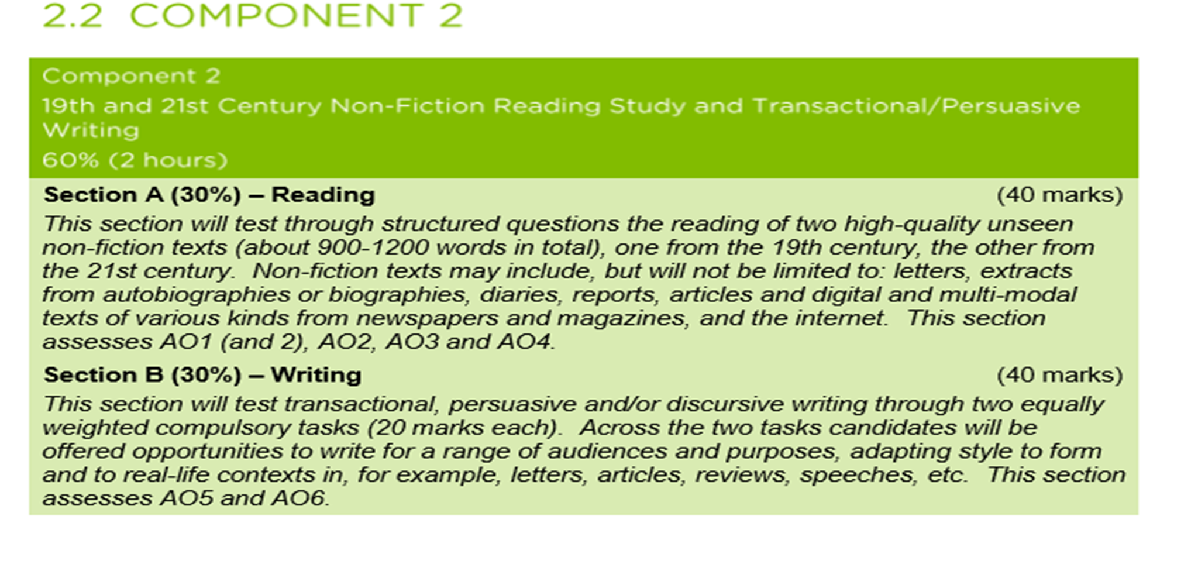
LO: to maximise marks in P2

Slide 2
Spider diagram a range of non-fiction texts
CHALLENGE: add modern non-fiction texts

Slide 3
Question types
Q1: INFORMATION RETRIEVAL
Q2: ANALYSE HOW THE WRITER PERSUADES/IDENTIFY TECHNIQUES/HOW ARGUMENT IS CONSTRUCTED
Q3: INFORMATION RETRIEVAL (2ND TEXT)
-EXPLAINING IDIOMS/WORDS
-SELECT EVIDENCE (2 MARKS) X 2
Q4: THINK AND FEEL QUESTION/OPINIONS
Q5: COMPARING TEXTS-SUMMARY/OVERVIEW OF 2 TEXTS AND SIMILARITIES
Q6: COMPARING TEXTS-BOTH SIMILARITIES AND DIFFERENCES BETWEEN TEXTS

Slide 4
Read both texts about Disability
Read Lines 1 to 10 of Source A extract from My Left Foot
A1:
Where was he born?
How was the birth described?
What delayed his baptism?
Answers- GREEN pen
He was born in ‘the Rotunda Hospital’
He was informed it was ‘ a difficult birth’ because both he and his mother almost died
His baptism was delayed until his mother was well enough to take him to church.

Slide 5
Read both texts about Disability
A2. Christy Brown is describing his mother’s unfailing faith in his mental ability. How does he do this? [10]
You should comment on:
What he says to influence readers;
His use of language and tone;
The way he presents his argument.

Slide 7
mother’s faith in me seemed almost an impertinence.
refused to accept
that I was beyond cure, beyond saving, even beyond hope. She could not and would not believe that I was an imbecile,
smallest shade of doubt
Determined
momentous decision
to help me fight all the battles
But mother wasn’t content just to say that I was not an idiot, she set out to prove it, not because of any rigid sense of duty, but out of love.

Slide 9
Read both texts about Disability
A2. Christy Brown is describing his mother’s unfailing faith in his mental ability. How does he do this? [10]
You should comment on:
What he says to influence readers;
His use of language and tone;
The way he presents his argument.
How can we make this better?
Christy explores how a mother’s love is unconditional in ‘mother’s faith in me seemed almost an impertinence.’ The noun ‘impertinence’ suggests he ignored medical advice to the point of rudeness as she ‘refused to accept’ their decisions. The verb ‘refused’ indicates she was indignant to accept he was ‘ beyond cure, beyond saving, even beyond hope’ . The rule of 3 and repetition emphasise how she believed he could achieve and the emotive language reveals and mother’s hope and love for her child. He describes his mother to readers is a ‘Determined’ way to show her strength and belief. After describing the medical decisions, he then describes his mother’s attitude and then her actions, described as a ‘momentous decision’ and then adjective ‘momentous’ reveals how life changing her positive attitude towards disability and hope was….

Slide 10
LO: to answer a HOW question above 5 marks
To answer the following questions you will need to read Source B The Elephant Man
A3. (a) What does the writer mean by “embodiment of loneliness” [1]
(b) What does the writer describe John Merrick as? [2]
Answers: GREEN pen
He represented everything that loneliness meant
He is described as a ‘freak show’ and ‘the elephant man’ due to his deformities.

Slide 11
What do you need to do?
A4. What do you think and feel about the writer’s opinions of John Merrick?
[10]
You should comment on:
What is said;
How it is said.
You must refer to the text to support your comments
Opinions, views, beliefs
Feelings, thoughts, agree, sad, happy, disagree
Quotes
Analyse them whilst giving your opinion

Slide 13
Over this the creature was huddled to warm itself
this hunched-up figure was the embodiment of loneliness
captive in a cavern or a wizard watching for unholy apparitions in the ghostly flame.
The thing arose
the most disgusting specimen of humanity that I have ever seen
such a degraded or perverted version of a human being as this lone figure displayed.
The back was horrible, because from it hung, as far down as the middle of the thigh, huge, sack-like masses of flesh covered by the same loathsome cauliflower skin.
Although he was already repellent enough, there arose from the fungous skin-growth with which he was almost covered a very sickening stench which was hard to tolerate.

Slide 14
How do you answer a thoughts/feelings question?
WORD BOX:
Clearly
Evidently
Undoubtedly
Effectively
Successfully
Persuasively
Convincingly
Believably
Personally
I think, believe, assume, judge, support, disagree, agree…
Personally, I think the writer’s views were negative about John Merrick in ‘ the creature was huddled to warm itself’. I think the noun ‘creature’ is outdated and offensive today; it describes him like an animal rather than a human being and I believe this to be intolerant of disabilities. I agree that ‘this hunched-up figure was the embodiment of loneliness’ because the noun ‘embodiment’ shows he was isolated from humans and treated like something to be watched- the negative views people held of him meant his life was lonely and alienated from society as he was classed as a ‘freak show’. Evidently, he is ignorant to disabilities in ‘the thing arose’ as I think the noun ‘thing’ shows the writer chooses not to acknowledge him as a human being and this is disgusting attitude to have. …

Slide 15
LO: to answer compare and contrast questions
List comparing connectives
Similarly
In a similar way
Likewise
Alike
Differently
In a different way
Contrastingly
In contrast to
On the other hand
alternatively
Task 2 – Read the sentences below and highlight /shade the four different word classes.
NOUNS ADJECTIVES VERBS ADVERBS
At the airport, Josh happily watched the huge planes.
Kate quickly ran into the immense shop.
Excitedly, we walked across the silky sand.
John silently admired the ancient building.

Slide 16
To answer the following questions you will need to use both texts. A5. According to these two writers, how were the two people treated very differently as a result of their disabilities? [4]
Supported and encouraged
Belief and hope
Disgust
Dehumanises him
In ‘My Left foot’ the writer describes being supported in ‘ refused to accept this truth’ which showcases her belief and hope that he could succeed regardless of his disability. She encouraged him to try to develop as she believed he was not ‘beyond cure’ and she challenged the notion of being an ‘imbecile.’ In ‘Elephant Man’, the writer shows he was treated like an animal in ‘ speaking as if to a dog’ which implies he was degraded and treated with hostility. The writer also dehumanises him in ‘the thing’ and shows how he was treated without respect or dignity.

Slide 17
A6. Both of these texts are about the treatment of people with a physical disability. Compare the following:
The writers’ attitudes towards disabilities;
How they get across their arguments.
[10]
You must use the text to support your comments and make it clear which text you are referring to.

Slide 18
COMPARE AND CONTRAST
MY LEFT FOOT | ELEPHANT MAN
SADDENED by medical advice ‘labelled me a very interesting but also a hopeless case.’ | SADDENED BY WHAT HE SAW hunched-up figure was the embodiment of loneliness
SUPPORTED AND ENCOURAGED I would always have my mother on my side to help me fight all the battles
PEOPLE DISMISSED HIM AS A HUMAN But it wasn’t easy for her because now the relatives and friends had decided otherwise. | PEOPLE DISMISSED HIM AS A HUMAN ‘the creature’ and ‘the thing’
APPRECIATED AND VALUED Luckily for me, … out of love’

Slide 19
Clearly, the writer in ‘My Left Foot’ felt ……….. In ‘ …………………….’ which shows ……………………………………………………………………………..
Similarly, the writer of ‘Elephant Man’ felt ….. In ‘ ………………………’ which reveals …..

